Slide 2
REED ADMISSION
Welcome to Junior Visit Day

Slide 3
HEAD
NUMBERED LIST
Number one.
Number two.
NUMBERED LIST
Number one.
Number two.
Number three.

Slide 4
BULLETED LIST
Website
Viewbook
Course Catalog
Orientation materials/tabling
Brochure
Facebook

Slide 5
LONGER BULLETED LIST
PE Department
PE Requirement
Club Sports
Sports Center (the facility itself)
Reed Outdoor Programs and Gray Fund outing events
Ski Cabin
Outing Club
Backpack Co-op

Slide 6

LIST WITH IMAGES
Text here.
BULLETS HERE
Bullet one
Bullet two
Bullet three
Bullet four

Slide 7
LISTS
LISTS
Athletics, Fitness, and Outdoor Programs
PE Requirement
Club Sports
ROPE
Gray Fund
Reed Outing Club
Backpack Co-op
Orientation Trips
Facilities
Sports Center
Ski Cabin
Staff
Athletics, Fitness, and Outdoor Programs
PE Requirement
Club Sports
ROPE
Gray Fund
Reed Outing Club
Backpack Co-op
Orientation Trips
Facilities
Sports Center
Ski Cabin
Staff

Slide 8
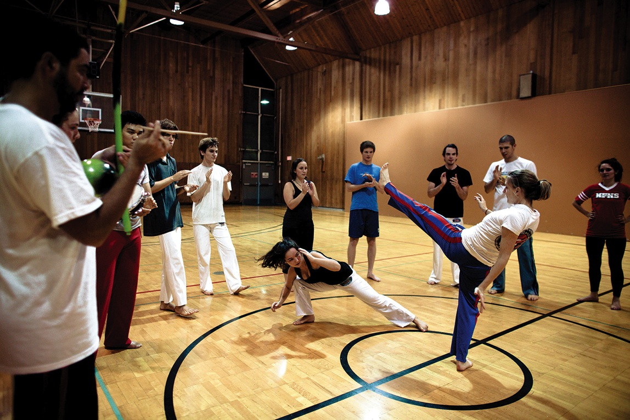
How to use large images
Caption here

