Slide 1
Designing a Halfpipe for Advanced Snurfers
One of the 2011 COMAP problems was optimizing the design of a halfpipe for professional snowboarders. We used a variety of methods and models to answer this problem. This presentation is a summary of how we used the 96 hours to determine, through mathematical models, the optimal shape of a halfpipe.
2011 COMAP Team:
          -Alexander Macavoy
          -Jadon Herron
          -Rachel Burton

Slide 2
Contents
What is COMAP?
Our Approach
  Two Dimensional Energy Model
  Two Dimensional Force Model
  Three Dimensional Force Model
Reality Check
Solutions and Conclusion

Slide 3
What is COMAP?
  COMAP (Consortium On Mathematics And its Applications)
  96 hour long worldwide mathematics marathon
  End result is a carefully worded technical article
  How can you place?
      Unsuccessful Participant
      Successful Participant
      Honorable Mention
      Meritorious
      Finalist
      Outstanding

Slide 4
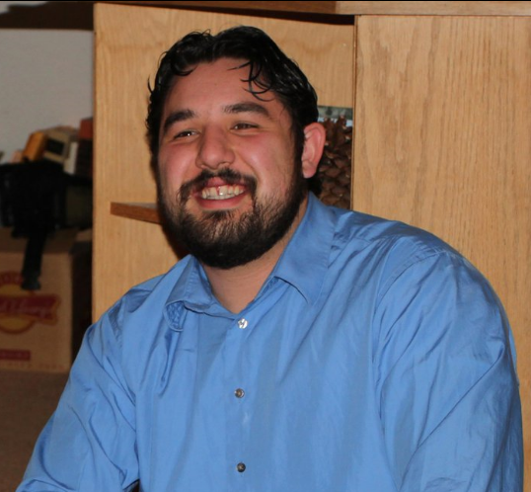
What kind of people do math for 96 hours?
Alexander Macavoy
Major: Mathematics
Minor: Geology, German
Current location: Tübingen, Germany
Why COMAP? It was mostly curiosity and what better way to celebrate 21 birthday?
Rachel Burton
Major: Mathematics
Minor: Physics, Biology, Chemistry
Why COMAP? I missed Physics and I was persuaded by Alex.
Jadon Herron
Major: Civil Engineering
Why COMAP? I have always like competition and I really enjoyed my physics and engineering classes.

Slide 5
Before the Contest Began…
Assigned roles and discuss schedule
  Alexander Macavoy-Computer Programmer
  Jadon Herron-Math Guy
  Rachel Burton-Writer/Taskmaster
Practice writing abstracts based on previous year’s problems
Reading through previous Outstanding papers

Slide 6
2011 COMAP Questions
Question A –Continuous Problem
-Determine the shape of a “halfpipe” snowboard course to maximize the production of “vertical air” by a skilled snowboarder.
Question B-Discrete Problem
-Determine the minimum number of VHF radio spectrum repeaters necessary to accommodate 1,000 simultaneous users in a 40-mile radius.

Slide 7
Contents
What is COMAP?
Our Approach
  Two Dimensional Energy Model
  Two Dimensional Force Model
  Three Dimensional Force Model
Reality Check
Solutions and Conclusion

Slide 8
Our Approach
Brainstorms! Brainstorm! Brainstorm!
Three Dimensional Models
Shaun White YouTube videos!
Snowboard lingo
  What is does a halfpipe look like?
  What is ‘vertical air’

Slide 9
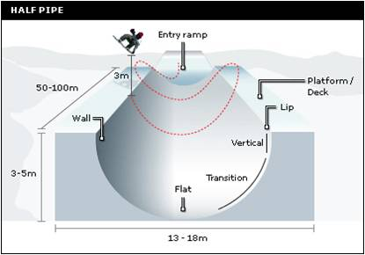
What is a half pipe?
Top of Mountain
Vertical Air
The average halfpipe is 10 m wide and 7 meters deep while the slope of the mountain varies.
Mountain Base

Slide 10
Our Three Models
Energy Model-Conservation of Energy
    Does not allow for any air resistance, friction, or centripetal acceleration
    Cross section of the halfpipe
Two dimensional Force Model-sum of the y,z forces
    Allows for the addition of work, air resistance, friction, and centripetal acceleration
    Cross section of the halfpipe
Three dimensional Force Model-sum of the x,y,z forces
    Allows for the addition of work, air resistance, friction, centripetal acceleration
    Three dimensional!

Slide 11
Contents
What is COMAP?
Our Approach
  Two Dimensional Energy Model
  Two Dimensional Force Model
  Three Dimensional Force Model
Reality Check
Solutions and Conclusion

Slide 12
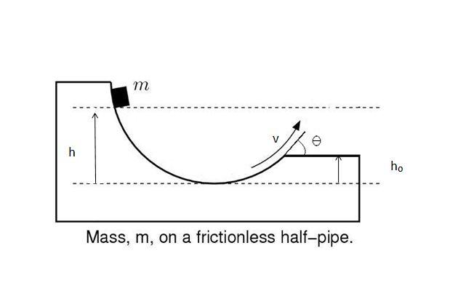
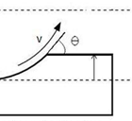
Two Dimensional Energy Model
Developed a model representing a two dimensional or “basic” halfpipe.
Theoretical model to help describe a simplistic view at what vertical air and factors like work would mean.
There were no computer simulations for this model
We want to maximize this velocity for optimal vertical air

Slide 13
The force model approach
Given a function of the shape of the halfpipe model the path of the snowboarder
Test different shapes of the halfpipe using the same force equations
Analyze the data to determine the best shape

Slide 14
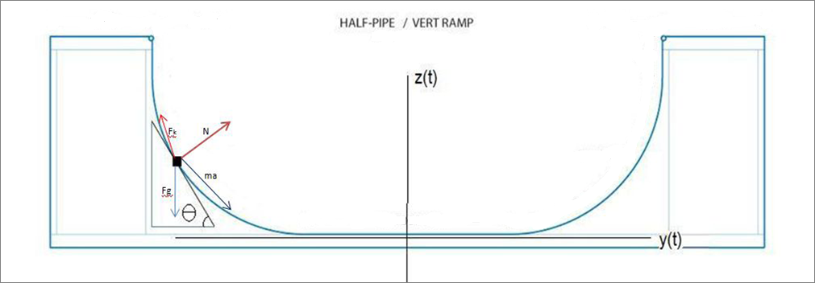
Two dimensional Force Model
Using Newton’s Second Law of Motion
F=ma
For the 2D model the forces are summed in the two directions giving two second order differential equations.
F_{z} =ma_{z}
F_{y} =ma_{y}

Slide 15
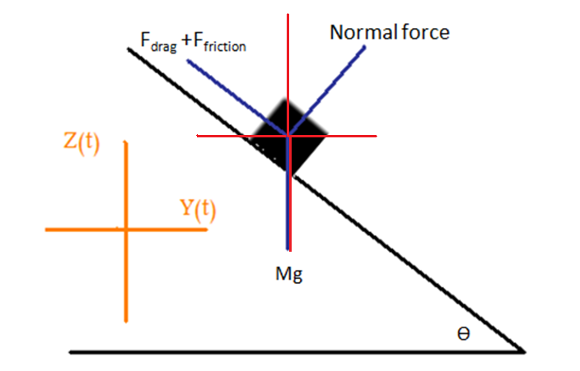
Componentizing the Forces
(F_{drag} +F_{friction} )sin(Ѳ) +
Ncos(Ѳ)
Ѳ
(F_{drag} +F_{friction} )cos(Ѳ)
Ѳ
Nsin(Ѳ)
mg
Ѳ=Ѳ(z,y)

Slide 16
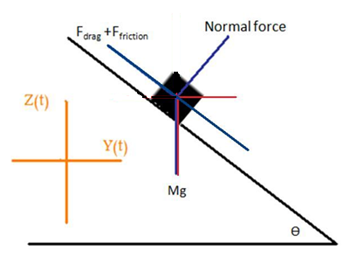
The Addition of Work
There is work being added to the system from the snowboarder
To model this force we added a constant force in the direction of travel of the snowboarder
WorkCos(Ѳ)
Work
WorkSin(Ѳ)

Slide 17
.
Two Dimensional Model
1. dv_{y} /dt=Nsin(θ)-(F_{drag} +F_{friction} )cos(Ѳ)+ (work)cos(Ѳ)
2. dy/dt=v_{y}
3. dv_{z} /dt= -g+Ncos(θ)+(F_{drag} +F_{friction} )sin(Ѳ)- (work)sin(Ѳ)
4. dz/dt=v_{z}
N=gcos(Ѳ)-(v_{y}² + v_{z}² )
ρ
F_{drag} =.5 ρ_{air} ac_{d} (v_{y}² + v_{z}² )
m
F_{friction} =μ N
ρ(z,y)= radius of curvature
=(1+(dz/dy)² )^{3/2}
d² z/dy²
Work=constant force
Ѳ=arctan(dz/dy)

Slide 18
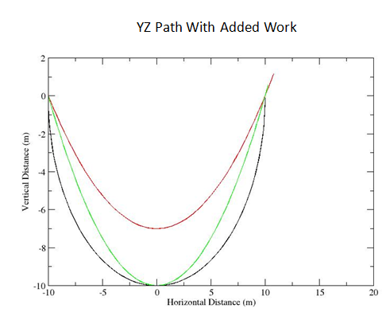
Computer Simulation
Next we used the fourth order Runge-Kutta approximation simulated with c++ to solve the four differential equations

Slide 19
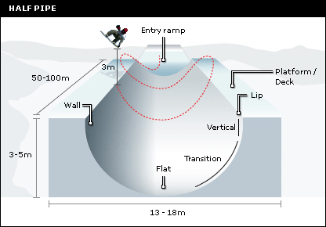
Three dimensional Force Model
The third dimension was added

Slide 20
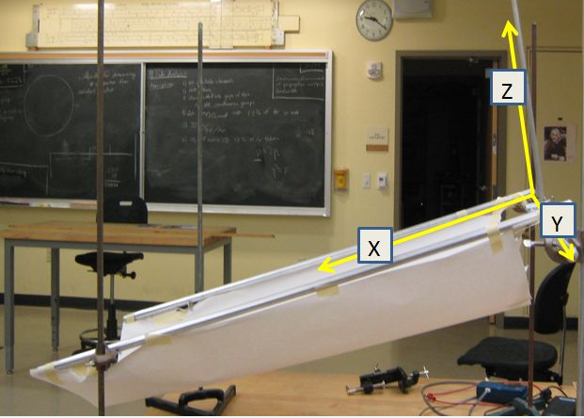
To find the equation for three dimensions we shifted the x, y, z axis

Slide 21
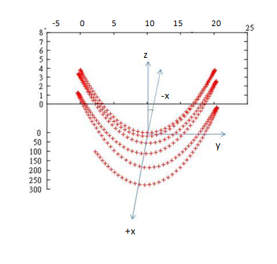
Three Dimensional Model
dv_{x} /dt=g sin(φ) ma – g cos(φ) μ –F_{drag} _{x}
dv_{y} /dt=N sin(Ѳ)- (F_{drag yz} +F_{friction} ) cos(Ѳ)+ (work) cos(Ѳ)
dv_{z} /dt= -g cos(φ) +N cos(θ)+(F_{drag yz} +F_{friction} ) sin(Ѳ)-(work)sin(Ѳ)
dx/dt=v_{x}
dy/dt=v_{y}
dz/dt=v_{z}
The big change from 2D
N=gcos(φ)cos(Ѳ)- (v_{y}² + v_{z}² )
ρ
Φ is a set angle and is the slope of the halfpipe on the hill

Slide 22
Contents
What is Comap?
Our Approach
  Two Dimensional Energy Model
  Two Dimensional Force Model
  Three Dimensional Force Model
Reality Check
Solutions and Conclusion

Slide 23
Computer Program Fidelity
Testing the 2D model
  Set the frictional and work force to zero
  Set the work equal to zero
Testing the 3D model
  Set φ, work, and the frictional forces equal to zero
  Set φ equal to zero
  Running the full 3D model and comparing the velocities with the 2D model

Slide 24
So…do these models work?
-Is the physics sound?
-Does the math match in the program like it does on paper?
-Did we answer the exact question?
-Does the paper reflect the hard work?

Slide 25
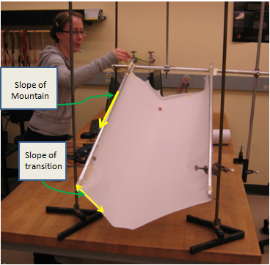
Testing Methods
“Snowboarder” =Marble
Physical Models:
glue guns, butcher paper, paper clips, weight stands ect.
Computer Modeling:
4th order Runge Kutta in C++
Free Body Diagrams
Shaun White videos (available on YouTube)
Suggested field testing

Slide 26
Contents
What is COMAP?
Our Approach
  Two Dimensional Energy Model
  Two Dimensional Force Model
  Three Dimensional Force Model
Reality Check
Solutions and Conclusion

Slide 27
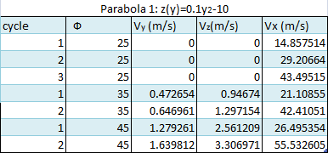
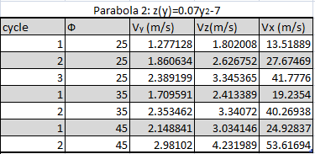
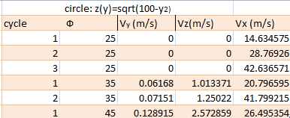
Comparing 3 Halfpipe Functions and 3 Mountain Slopes
Best Halfpipe function
Best Practical Mountain Slope
Optimal Vertical air

Slide 28
Our Solution
By comparing the data from three different functions and three different angles we were able to determine the best halfpipe for both an average snowboarder and an advanced snowboarder.
Practical halfpipe:
z(y) = 0.07y ² – 7
Slope of 25 ˚
Advanced halfpipe:
z(y) = 0.07y ² – 7
Slope of 45˚

Slide 29
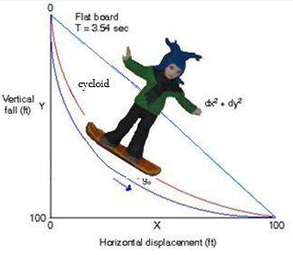
If we only had more time…
A possible future model could be a half-pipe down the slope given by the equation of a cycloid.

Slide 30
Special Thanks
Dr. Tovar- Thank you for all those C++ programs you assigned, for those long term papers that took up the entire dead week, for spending the extra time to coach us, and for persuading us to try.
Alexander Macavoy- Thank you for convincing us to do this competition even though you left us with all of the presentations
Reed College-For giving us the opportunity to present here.
EOU Math Club-getting us here and supporting us!
Shaun White for posting all your videos on YouTube and providing necessary information!

Slide 31
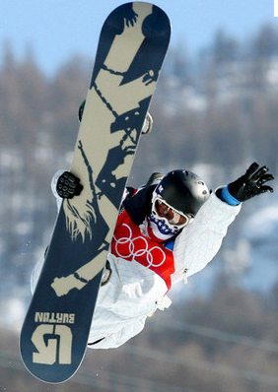
Just in Case…
studentsoftheworld.info

