Slide 1


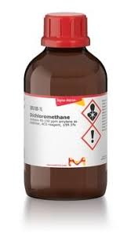

Methylene Chloride Training
Developed by CSHEMA.

Slide 2

Background

Slide 3
Background – EPA and TSCA
The Environmental Protection Agency (EPA) has authority to regulate chemical use under the Toxic Substances Control Act (TSCA).
Environmental preservation if a chemical can have harmful effects on ecosystems.
Protection of human health, if a risk assessment determines that a chemical can pose significant health risks.

Slide 4


Methylene Chloride Rule - 2024
In May 2024, the EPA published a new rule for methylene chloride (aka dichloromethane, DCM).
Most uses will be banned.
A few uses may continue if a Workplace Chemical Protection Program (WCPP) is established, including lab use and solvent welding.

Slide 5
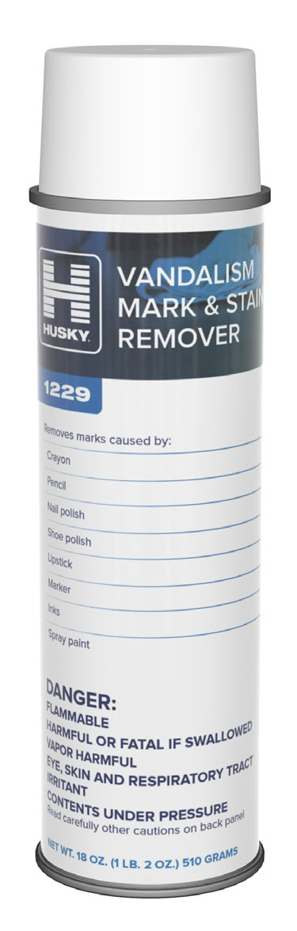

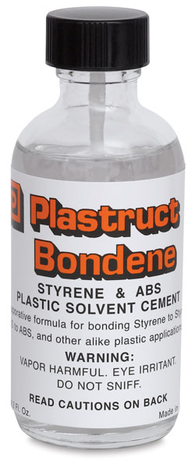
Where is Methylene Chloride Found?
Paint strippers
Varnish removers
Stain removers
Adhesive removers
Bonding products
Laboratory chemical
And others. . .

Slide 6
Methylene Chloride Chemical Characteristics
Clear and colorless volatile organic solvent.
Molecular weight of 84.9 grams/mole
High vapor pressure of 350.
Odor threshold of 125 ppm
Sweet, chloroform like odor.
If you can smell it, you are well over the exposure limit.

Slide 7
Key Regulatory Dates
May 5th, 2025
Initial exposure monitoring to determine each potentially exposed person’s exposure for continuing uses must be completed.
Distributing methylene chloride products for consumer use is prohibited.
August 1st, 2025 (or 3 months after testing)
Provide respiratory protection as outlined.
Require chemically-resistant gloves where dermal contact is possible.

Slide 8
Key Regulatory Dates
October 30th, 2025
Develop and implement an Exposure Control Plan.
April 28th, 2026
Most commercial uses are prohibited after this date.
May 8th, 2029
DCM may be used for very specific furniture refinishing and aerospace uses until this date, with protections.

Slide 9
Lab and Solvent Welding Requirements

Slide 10
Health Effects of Dichloromethane Exposure
Health impacts of dichloromethane (aka DCM, methylene chloride) exposure may include the following.
Respiratory and skin irritation from both short- and long-term exposure through inhalation or skin contact.
Neurotoxicity through short- and long-term inhalation exposure.
Liver impacts through chronic exposure.
Cancer risks through long-term exposure through inhalation or skin exposure.
It is important to limit exposure to DCM whenever possible to minimize the risk of injury.

Slide 11
EHS Approval
All uses of DCM must be reviewed and approved by the Department of Environmental Health & Safety.
Uses will be reviewed to determine if they are represented by previous monitored activities.
If not, initial monitoring will be required prior to DCM use.
A Lab/Shop Specific Exposure Control Plan (ECP) must be developed and provided to all potentially exposed persons. The ECP must be shared with EHS.

Slide 12
Workplace Chemical Protection Program (WCPP)
Workplace Chemical Protection Program (WCPP)
A written program to protect people engaged in conditions of use that are not prohibited, including lab use and solvent welding.
The institute’s WCPP can be found at www.reed.edu/ehs/safety-information-and-programs/.
Exposure Control Plan (ECP)
A document describing actions taken to mitigate occupational exposures and comply with the WCPP at the lab, department, or institute level.
Must include information on why DCM use cannot be eliminated and why there are no adequate substitutes.
A general ECP is provided by EHS within the WCPP. Laboratory/Shop specific ECPs must be developed and provided to all potentially exposed persons in that location.

Slide 13
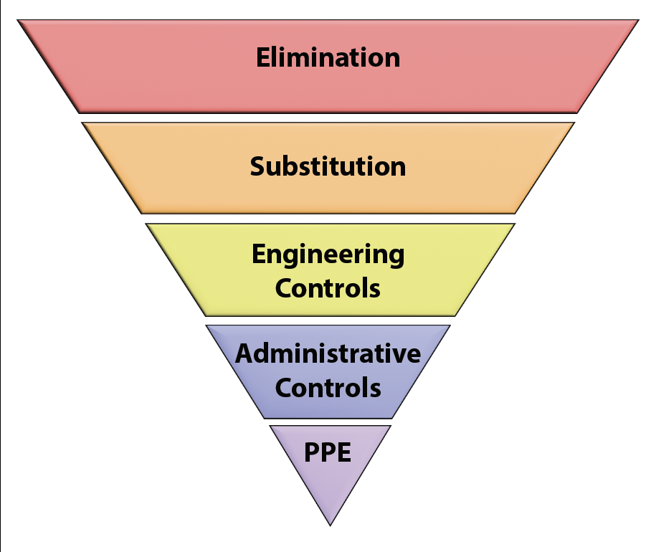
Implementing Exposure Controls
Users must implement each type of control when feasible.
Controls that are not used must be documented in the Exposure Control Plan (ECP).
Learn more about control types on the NIOSH Hierarchy of Controls webpage.

Slide 14
Elimination and Substitution
Elimination is the complete removal of DCM.
Substitution is the replacement of DCM with an alternative.
Assess the risks posed by potential substitutes.
Do not use a substitute that is more hazardous than DCM, such as chloroform, trichloroethylene, or n-propyl bromide due to toxicity or hydrochlorofluorocarbons due to ozone depletion.
Implement controls to address any risks from substitutes that are chosen.

Slide 15
Engineering Controls
When possible, perform work with DCM inside a fume hood.
Ensure hood is functioning properly.
Check for alarms.
Keep items not needed for the work out of the fume hood.
Glove boxes may be used to prevent exposure to DCM if the purge/exhaust line is connected to the building exhaust.
Use other ventilation controls, such as snorkels or exhausted enclosures, if fume hood or glove box use isn’t possible.
All engineering controls require proper training and an assessment of potential exposure by EHS.
Stop all use of DCM if any malfunction of the local exhaust ventilation is suspected.

Slide 16
Administrative Controls
Administrative controls are work practices employed to minimize the risk of exposure during the task by providing the worker with information on hazards and how to work safely.
Review the WCPP and ECP and agree to abide by the information in those documents and this training.
Review the manufacturer’s SDS and additional chemical safety information
Follow standard institute policies for chemical storage and disposal.
Develop written emergency response procedures for unexpected events, such as spills, alarms, unexpected reactions, exposures, etc.

Slide 17
Personal Protective Equipment
Personal protective equipment (PPE) is comprised of clothing and equipment worn to provide a barrier between a hazard and an individual.
PPE is the last line of defense against exposure when other controls are not sufficient or where operations require direct contact with a hazard.
Individuals working with DCM must wear appropriate PPE whenever there is a risk of contact with the chemical.

Slide 18
Personal Protective Equipment
PPE Type | Requirement
Attire | A combination of clothing and shoes that fully cover the legs and feet.
Lab Coat | Required when handling DCM.
Eye Protection | Safety glasses with side shields at a minimum. Safety goggles when there is a greater risk of splashes and for spill cleanup.
Respiratory Protection | Respiratory protection should not be needed if using engineering controls. Where required, additional training and entry into a respiratory protection program is required. Purifying respirators are not allowed for DCM.

Slide 19

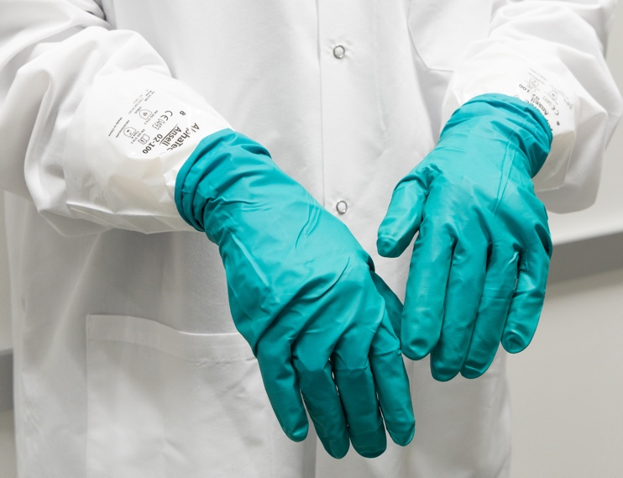
Glove Use
Low-Risk Work
Examples: Small volumes, low splash risk.
Double-glove with nitrile or nitrile/neoprene combination gloves (ex. Ansell 93-260).
Higher-Risk Work
Examples: Spill cleanup, large volumes, or greater splash or contact risk.
More resistant glove such as Ansell 02-100 liners or SilverShield gloves under a nitrile or nitrile/neoprene glove.
Note that compatibility with other chemicals in use must also be assessed.
2-100 liners
+
93-260 gloves

Slide 20
Glove Use Tips
Check that gloves meet the following guidelines.
Clean and fit well - snug but not too tight, allowing full range of motion.
Compatible and appropriate to the hazards, including DCM and other chemicals in use at the same time.
Covers hands and wrists in combination with lab coat.
Chosen to provide desired level of dexterity for procedures.

Slide 21
Gloves Use
Store gloves away from moisture or direct sunlight.
Minimize contact and splashing as much as possible.
Monitor the condition of the gloves before and during use. Do not use if there are damaged or show signs of wear, such as holes, tears, or discoloration.
Change disposable gloves frequently.

Slide 22
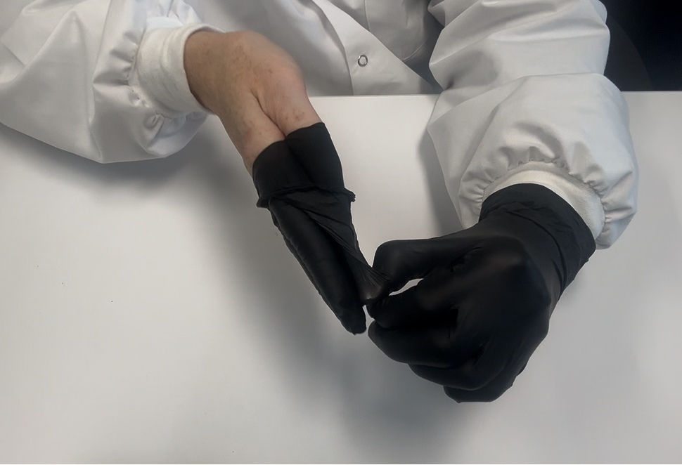
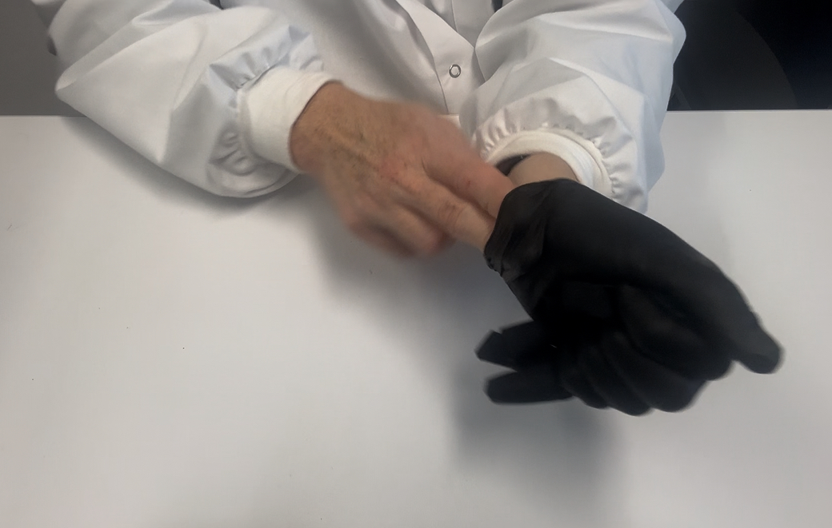
Gloves Removal
Ensure the glove exteriors do not touch your skin during removal.
Pinch the wrist of one glove without touching your skin and peel it off, turning it inside out.
Slide an ungloved finger under the wrist of the remaining glove and peel it off, enclosing the first glove inside.
Place the gloves in a designated hazardous waste container.

Slide 23
Avoid Cross-Contamination
Avoid touching personal items like cell phones while wearing gloves.
Do not touch your face or clothing with gloves.
Limit wearing gloves outside the lab whenever possible.
Follow the One Glove Rule outside the lab - keep one hand ungloved for common surfaces.
Wash your hands after removing gloves and before leaving the lab.

Slide 24
Emergency Procedures
Skin Contact
Treatment starts immediately following exposure. Do not wait to remove chemicals once they are on the skin.
Remove all potentially contaminated clothing and jewelry and treat as hazardous waste.
Flush affected skin area using sink if on hands or arms or safety shower for 15 minutes.
Take a copy of the SDS and seek medical attention if needed. The nearest hospital is Providence Portland Medical Center at 4805 NE Glisan St, Portland, OR 97213.
Notify Human Resources (HR) and EHS of exposure and medical treatment.
Eye Contact
Rinse eyes at an eyewash station for at least 15 minutes. Be sure to hold the lids open.
Seek medical attention.
Notify Human Resources (HR) and EHS of exposure and medical treatment.

Slide 25
Emergency Procedures
Inhalation
Move to a location with fresh air.
Seek medical attention.
Notify Human Resources (HR) and EHS of exposure and medical treatment.
Ingestion
Do not induce vomiting if DCM is swallowed.
Never give anything by mouth to an unconscious person.
Call 911 for medical assistance. Call Community Safety at 503-788-6666.
Notify Human Resources (HR) and EHS of exposure and medical treatment.

Slide 26
Emergency Procedures
Sharps Injury
Injection of DCM, such as through a needlestick injury, can cause significant tissue damage. See “Safety First: A Recent Case of a Dichloromethane Injection Injury” (ACS Cent. Sci. 2020, 6, 2, 83–86). Note that there are graphic images in the paper.
Seek immediate medical assistance.
Notify Human Resources (HR) and EHS of exposure and medical treatment.
Significant tissue damage may occur without prompt treatment at a hospital. Clearly state that dichloromethane (methylene chloride) was involved in the injury, provide the SDS, and describe any symptoms such as discoloration or feeling of heat in the affected area.

Slide 27
Emergency Procedures
Spills outside fume hood or ventilated enclosure:
Alert others of the spill.
Evacuate to a safe distance, ideally exiting the lab and closing the door, and prevent entry.
Contact EHS at 503-777-7788 during business hours or Community Safety at 503-788-6666 after hours.
Remain in a safe location until EHS or other response personnel arrive.

Slide 28
Emergency Procedures
Spill inside fume hood or ventilated enclosure less than 500 mL:
A person may assist in the clean-up effort of small amounts of DCM in a properly functioning fume hood if trained and comfortable.
Wear PPE described above and use appropriate spill supplies such as absorbent pads and tongs.
Collect debris in appropriate container made of a compatible material such as high-density polyethylene (HDPE) that can be sealed.
Label container with appropriately completed hazardous waste label
Move container to the Chemistry 211 or contact EHS for help moving.
If not trained or if uncomfortable with cleanup, close the fume hood sash and contact EHS.

Slide 29
Record Your Training Completion
Please complete the Reed College Methylene Chloride Training Completion Form at the following link: https://forms.gle/xQwydv2XR8iJuRx87

Slide 30
Resources
Risk Management for Methylene Chloride - EPA webpage for DCM
FACT SHEET: Regulation of Methylene Chloride under TSCA - 2-page summary of key points in the EPA rule.
COMPLIANCE GUIDE: Regulation of Methylene Chloride under TSCA - Guide the EPA published to assist with compliance.
Final Risk Management Rule for Methylene Chloride - This is the complete, official rule published in the Federal Register.

