Slide 1
Trends in “Evening Element” Position in Promoter Regions
Leila Shokat

Slide 2
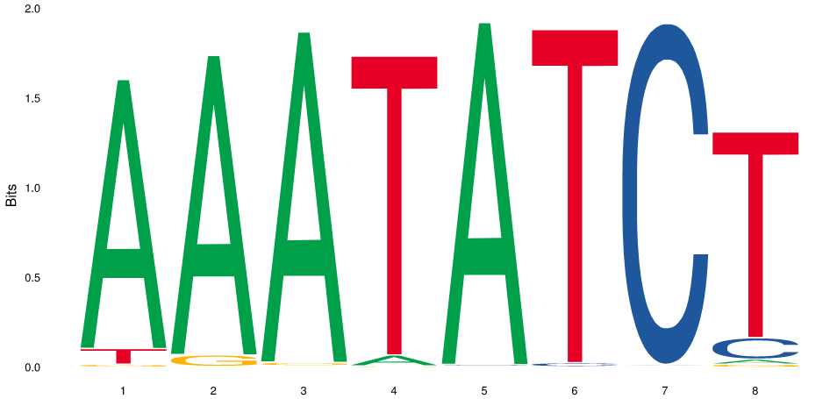
How biologically important is the “Evening Element”?
The Evening Element is a motif in the promoter regions of genes that are regulated by CCA1
8 base pairs long
JASPAR. http://jaspar.genereg.net/.

Slide 3
Why does it matter where motifs appear in the promoter?
Most biologically relevant regulatory motifs have consistent positions in promoter regions of genes
Uniformity is an indicator of biological relevance of the regulatory element
Casimiro, A. C., Vinga, S., Freitas, A. T., & Oliveira, A. L. (2008). An analysis of the positional distribution of DNA motifs in promoter regions and its biological relevance. BMC Bioinformatics, 9, 89. http://doi.org/10.1186/1471-2105-9-89

Slide 4
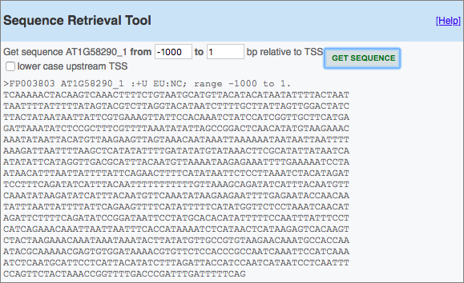
How I found my data
I used a paper that had researched the targets of CCA1 in Arabidopsis thaliana (thale cress)
They listed genes that were found to be influenced by CCA1
To find their promoter sequences, I searched the Eukaryotic Promoter Database
I put these sequences into .txt files in my repl
Nagel, D. H., Doherty, C. J., Pruneda-Paz, J. L., Schmitz, R. J., Ecker, J. R., & Kay, S. A. (2015). Genome-wide identification of CCA1 targets uncovers an expanded clock network in Arabidopsis. Proceedings of the National Academy of Sciences of the United States of America, 112(34), E4802–E4810.
Eukaryotic Promoter Database. https://epd.vital-it.ch/index.php.

Slide 5
High-level steps of my code
Construct a list of the promoter sequences
For each hamming distance you want to measure (in this case 0, 1, and 2), go through each gene:
Find all the k-mers that have this hamming distance from the motif of interest
Save the positions of the k-mers and the name of the gene in a dictionary
Graph each of the k-mers onto a graph

Slide 6
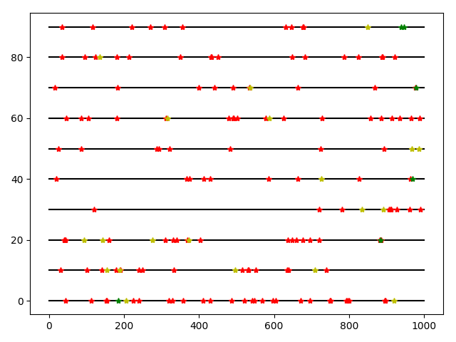
Results
HEMA1
REV1
ABCG2
CAT3
ERD7
CP122
AT4G14300
JMJD5
LNK3
DREB2C
Hamming Distance:
= 1
= 2
= 3
Coding Region of Gene

