Slide 1
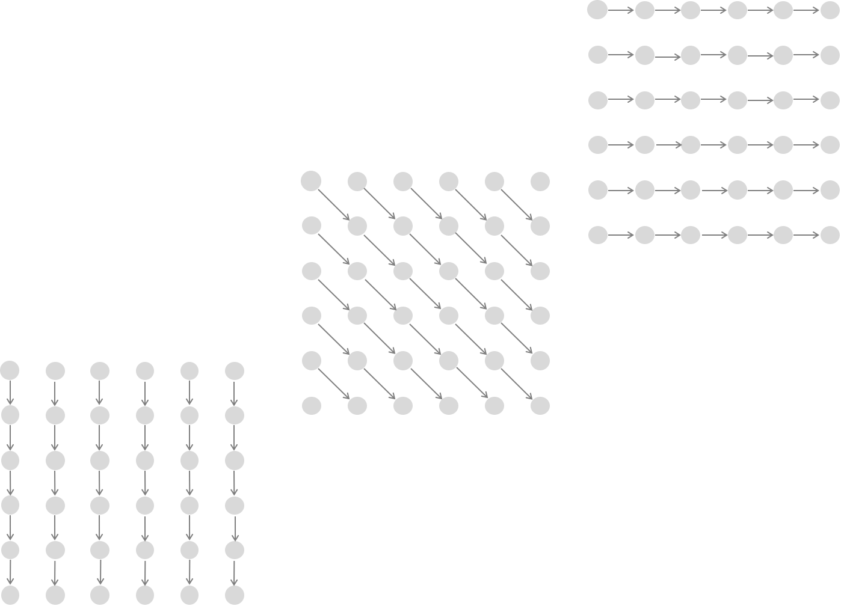
Affine Gap Alignment
(y’know, the one with σ and ε)

Slide 2


Why?
Realism
Control
Readability
Consider:
String 1: ACCCCCCCCCA
String 2: ATCCTA

Slide 3
What changes could transform string 1 into string 2?
String 1: ACCCCCCCCCA
String 2: ATCCTA
Scenario 1:
Insert Ts
Delete Cs

Slide 4
What changes could transform string 1 into string 2?
String 1: ACCCCCCCCCA
String 2: ATCCTA
Scenario 2:
Transform Cs to Ts
Delete Cs

Slide 5
What changes could transform string 1 into string 2?
String 1: ACCCCCCCCCA
String 2: ATCCTA
Scenario 3:
All Cs are deleted
TCCT is inserted

Slide 6
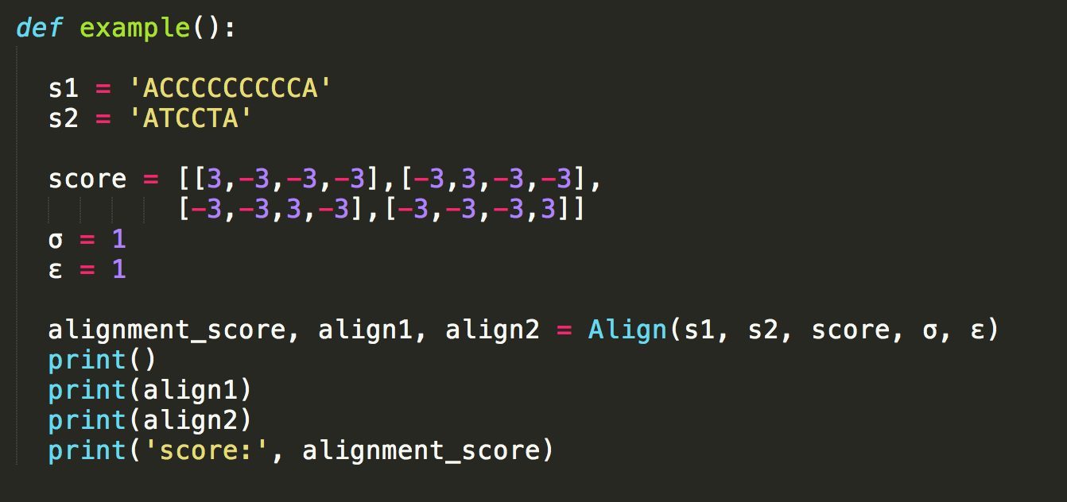
All gaps created equal
<—

Slide 7

-σ = - 1
-ε = - 1
Which scenario does this reflect?

Slide 8
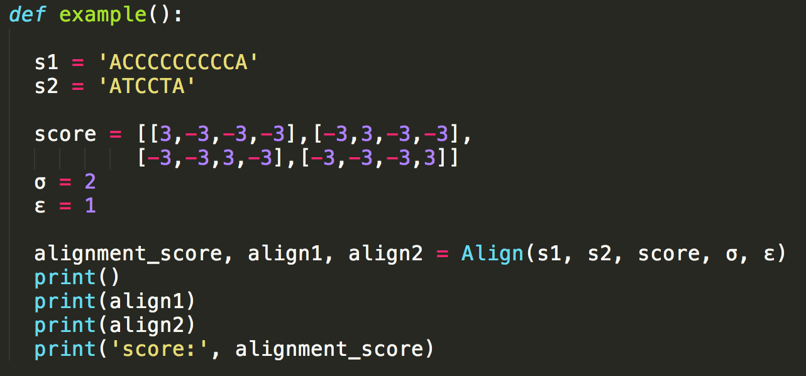
Some gaps more equal than others
<—

Slide 9

-σ = - 2
-ε = - 1
Which Scenario does this reflect?

Slide 10
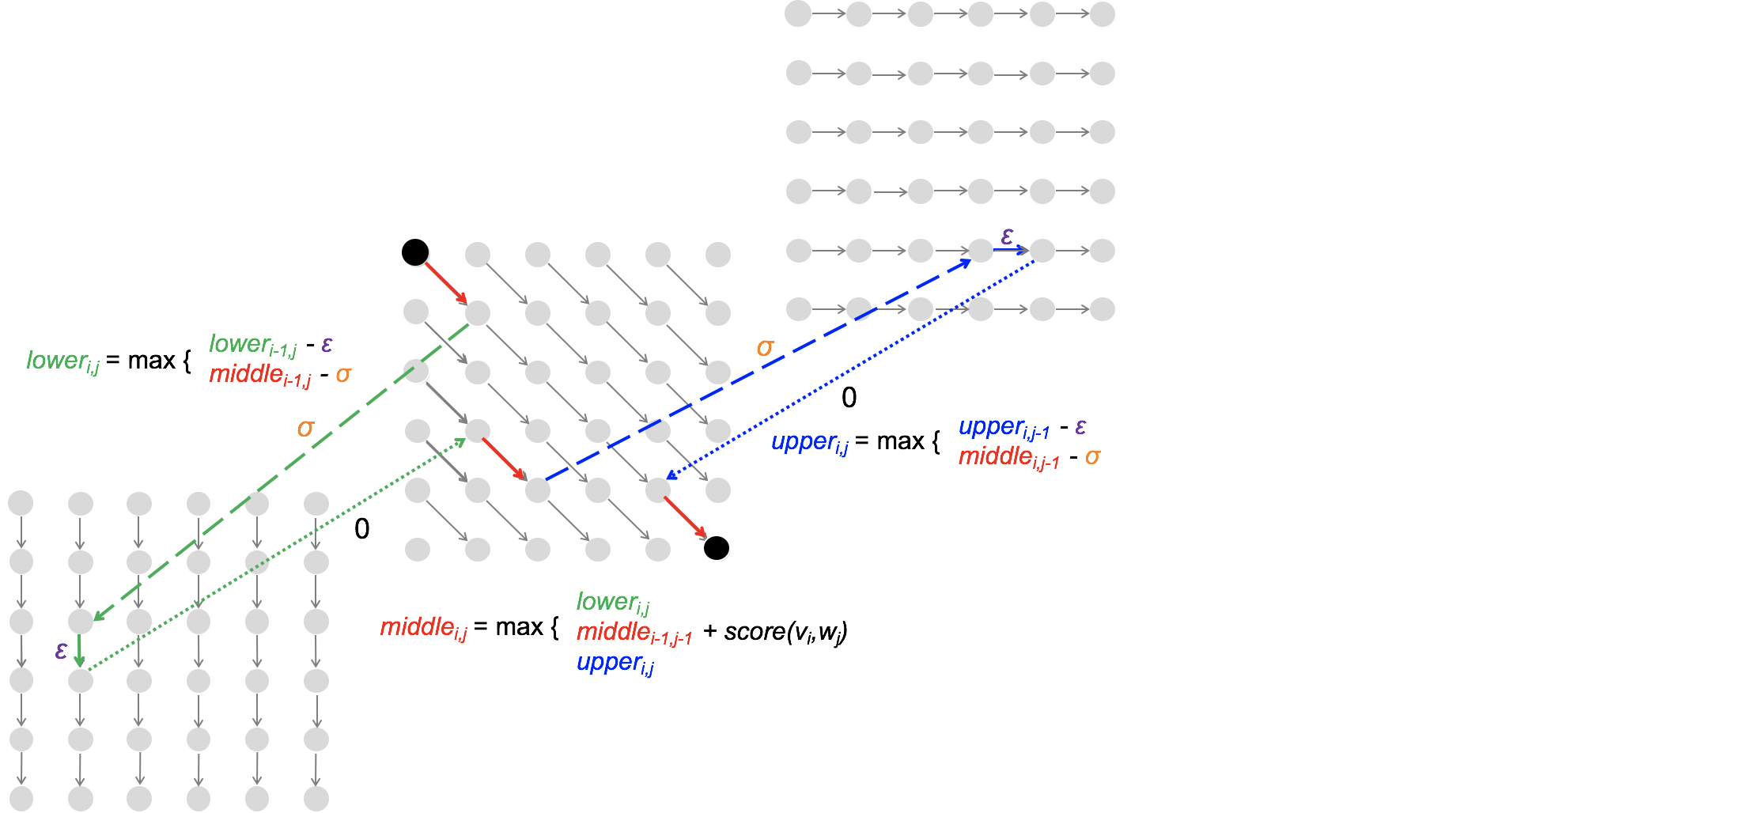
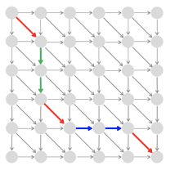
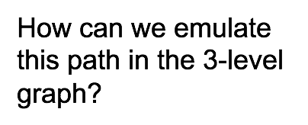

Slide 11
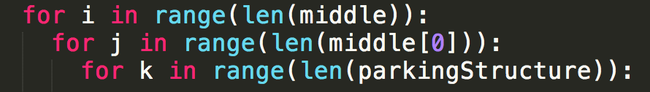
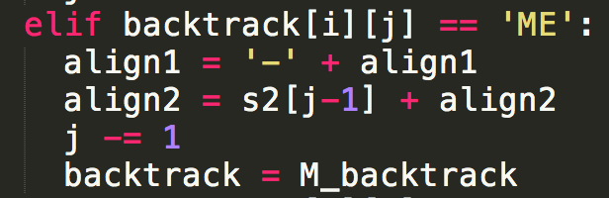
How though?
Six tables
Initial middle
Triple loop
Backtrack as [source table, direction]

Slide 12
HAGS

