Slide 1

DNA Methylation
Kat Kessler, James Vesto

Slide 2
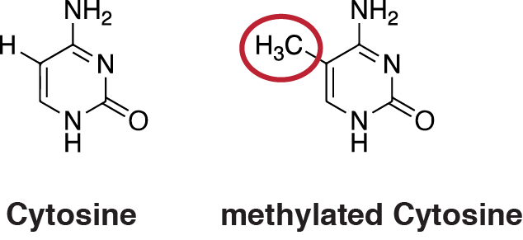
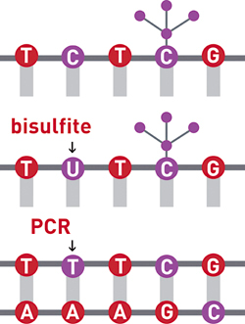
DNA Methylation Quantification
What is DNA Methylation?
How do we know if we
have methylated DNA?
Why do we care?

Slide 3
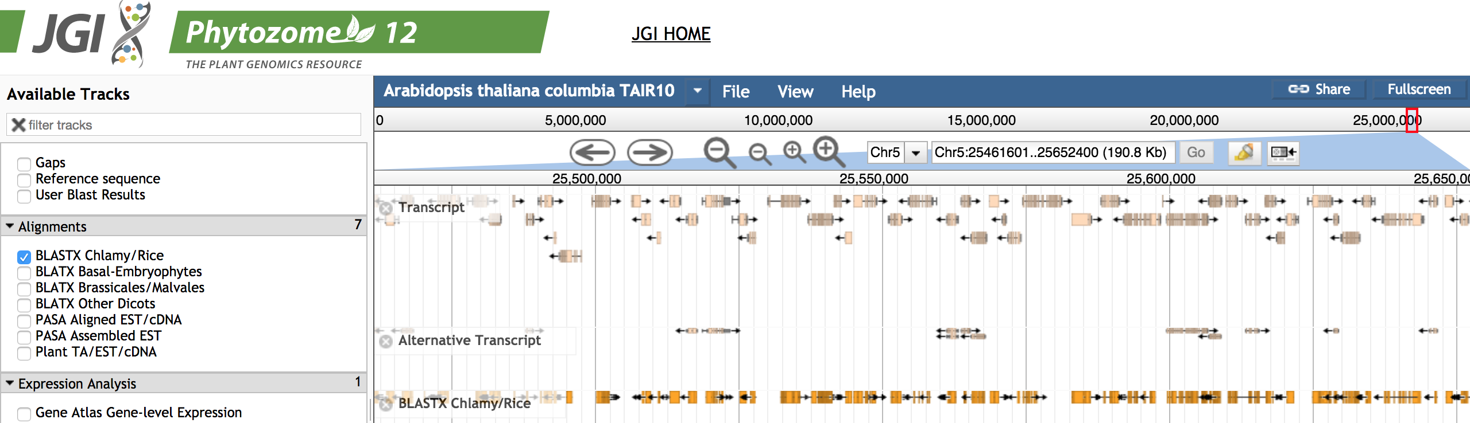
Data
Sanger sequence?
Simulate toy sequences by randomly changing C → T
  Keep track of how many are changed/conserved

Slide 4
Main( )
original ← String of Known
experimental ← String of DNA Toy Data
Orientation, Original Align, Experimental Align ← Align main(original, experimental)
Methylated count, Possible count, CPG Methylated Count, CPG Possible count ←
methyl(Original alignment, Experimental alignment)
Percent score, Percent CPG score ←
Percent methyl(Possible Count, Methylated Count, CPG Possible Count, CPG Methylated Count)
return

Slide 5
Align main (original, experimental)
Indel ← -1
Match ← +1
Mismatch ← -1
Score, Ori Align, Exp Align ← Global Align (Original, Experimental, Indel, Match,
Mismatch)
if Lagging Score > Lead Score or (Lag Score < Lead Score)
Orientation ← "Lag” or "Lead"
Align Original ← Lag Ori Align or Lead Ori Align
Align ← Lag Exp Align or Lead Exp Align
return Orientation, Original Align, Experimental Align

Slide 6
Methyl(Original, Experimental, Orientation)
if Orientation = lead or lag
nucleotide ← C or G
CPG ← G or C
for i ← 0 to |original|
if original[i] = nucleotide
Possible Count ← Possible Count + 1
if experimental[i] = nucleotide
Methylated Count ← Methylated Count + 1
if i>0 and original[i-1] or [i+1] = CPG
CPG Possible Count ← CPG Possible Count+1
if experimental[i]= nucleotide
CPG Methylated Count ← CPG Methylated Count + 1
return Methylated count, Possible count, CPG Methylated Count, CPG Possible Count

Slide 7
Obtaining Percentage of Conserved Cytosine
Create alignment – keep track of C and CpG
  GlobalAlign → LCS
    Indels, matches, mismatches?
    Forward/reverse?
Conserved C / Total C
CpG complexes?
  Conserved CpG / Total CpG
    How to include in results

Slide 8
Results
Both forward and reverse alignments and their LCS
Run forward or reverse methylation function – conserved nucleotides!
  C → T
  G → A
Nucleotide counts
Overall percent methylation
CpG methylation
Toy data had 65 possible sites of methylation , 41 conserved nucleotides, obtained 53.846% methylation, expected 63.07% methylation
  Molecular information!

