Slide 1
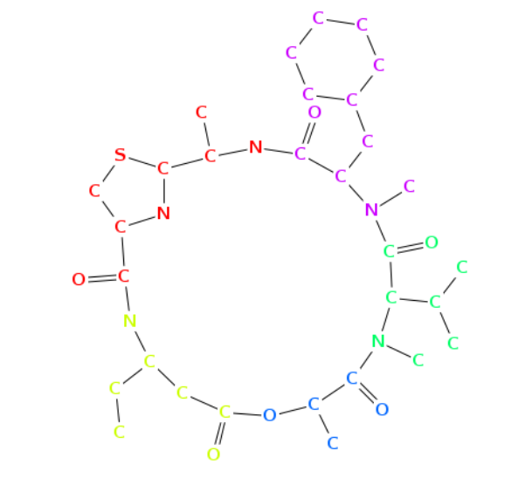
Cyclopeptide Sequencing
Obyanamide, a non-ribosomally produced antitumor. From Norine database.
Tayla Isensee

Slide 2
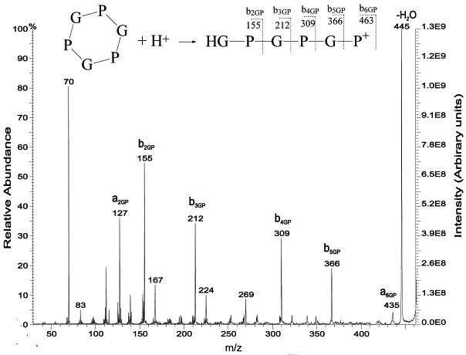
Problem: Antibiotics are not in the genome
Solution: Mass Spectrometry
Coding Problem: Brute force takes too long
Solution: Branch and bound
Candidates: ['PG', 'PA', 'PS', 'PP', 'PV', 'PT', 'PC', 'PI', 'PL', 'PN', 'PD', 'PK', 'PQ', 'PE', 'PM', 'PH', 'PF', 'PR', 'PY', 'PW', 'PG', 'PA', 'PS', 'PP', 'PV', 'PT', 'PC', 'PI', 'PL', 'PN', 'PD', 'PK', 'PQ', 'PE', 'PM', 'PH', 'PF', 'PR', 'PY', 'PW', 'VG', 'VA', 'VS', 'VP', 'VV', 'VT‘...]
Peptides Kept: ['PV', 'PT', 'PC', 'VP', 'VV', 'VT', 'VC', 'TP', 'TV', 'TT', 'CP', 'CV']

Slide 3


Data
Spectrum = [0, 97, 97, 99, 101, 103, 196, 198, 198, 200, 202, 295, 297, 299, 299, 301, 394, 396, 398, 400, 400, 497]

Slide 4
High Level Steps
CyclopeptideSequencing(Spectrum)
Peptides ← a list
while Final Peptides is empty:
Peptides ← Expand(Peptides)
for each peptide Peptide in Peptides
if Mass(Peptide) is in Spectrum
KeptPeps = KeptPeps + peptide
if Cyclospectrum(Peptide) = Spectrum
Final Peptides + Peptide
output Final Peptide
Peptides = KeptPeps
clear KeptPeps
CyclopeptideSequencing(Spectrum)
Peptides ← a set containing only the empty peptide
while Peptides is nonempty
Peptides ← Expand(Peptides)
for each peptide Peptide in Peptides
if Mass(Peptide) = ParentMass(Spectrum)
if Cyclospectrum(Peptide) = Spectrum
output Peptide
remove Peptide from Peptides
else if Peptide is not consistent with Spectrum
remove Peptide from Peptides

Slide 5
Results
Program can sequence cyclic peptides!
  But…runtime limits the length of peptide (no leaderboard)
  And…LOTS of assumptions about the fidelity of the data
Spectrum = [0, 97, 97, 99, 101, 103, 196, 198, 198, 200, 202, 295, 297, 299, 299, 301, 394, 396, 398, 400, 400, 497]
Possible Amino Acid Sequence = PVCPT
Mass Sequence
= 97-99-103-97-101

Slide 6

Conclusion
Program works on highly improbable, perfect datasets
Improving runtime, either with more expansive bounding or implementing a leaderboard
But… NRPs can contain more than 20 aa’s (100s),
It isn’t science unless you find a cool database =

