Slide 1
Finding a Eulerian Cycle in a Directed Graph
Natasha baas-Thomas

Slide 2
Eulerian Cycles
Graph: nodes with directed edges
Visit each edge only once, start and end at the same node
Useful for genomic sequencing

Slide 3
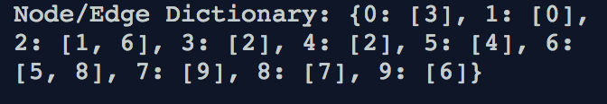
Data – example 1
→
Text file from http://rosalind.info/problems/ba3f → Dictionary of nodes (keys) and edges (values)

Slide 4
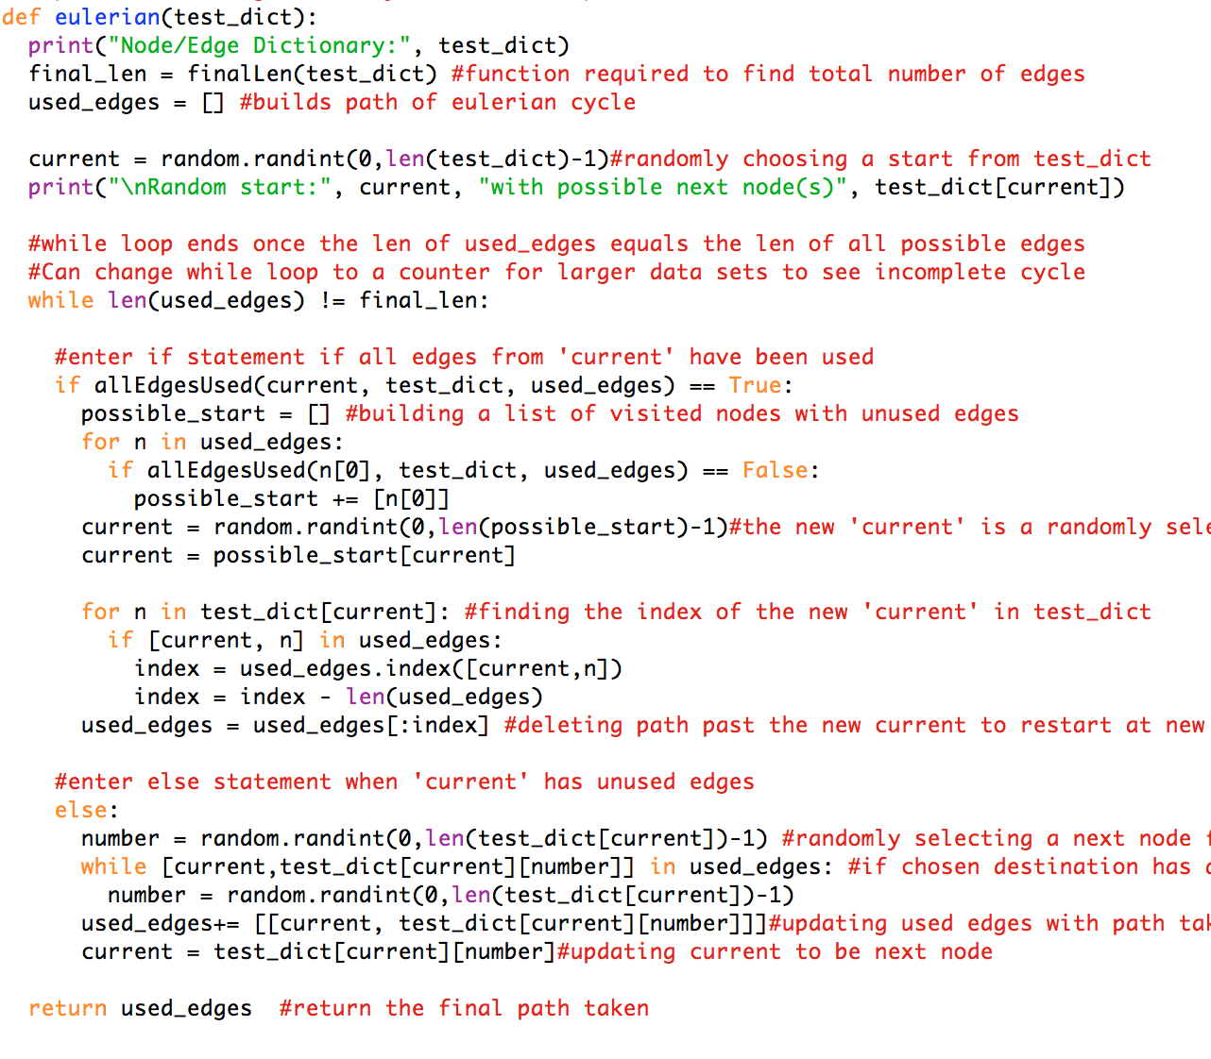
Code
Format data to a dictionary (input)
Random start -> ‘current’
Check if ‘current’ has unused edges:
if YES:
Randomly select a new edge to move to
if NO:
Randomly select a visited node with unused edges
Delete path after new ‘current’
Try again!
Finish once all edges have been visited once
Publish graph to GraphSpace
Notes:
Greedy algorithm

Slide 5
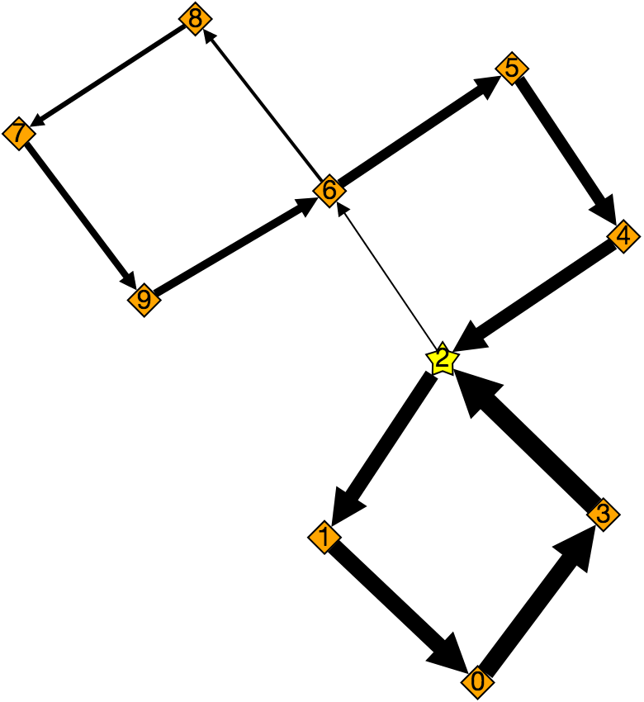
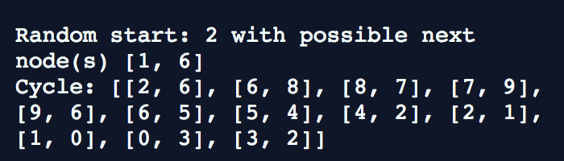
Output
Output:
List of lists: [[node1, node2], [node2, node3],…]
Graph:
Random start indicated by yellow star, with increasingly large edges as the cycle’s path

Slide 6
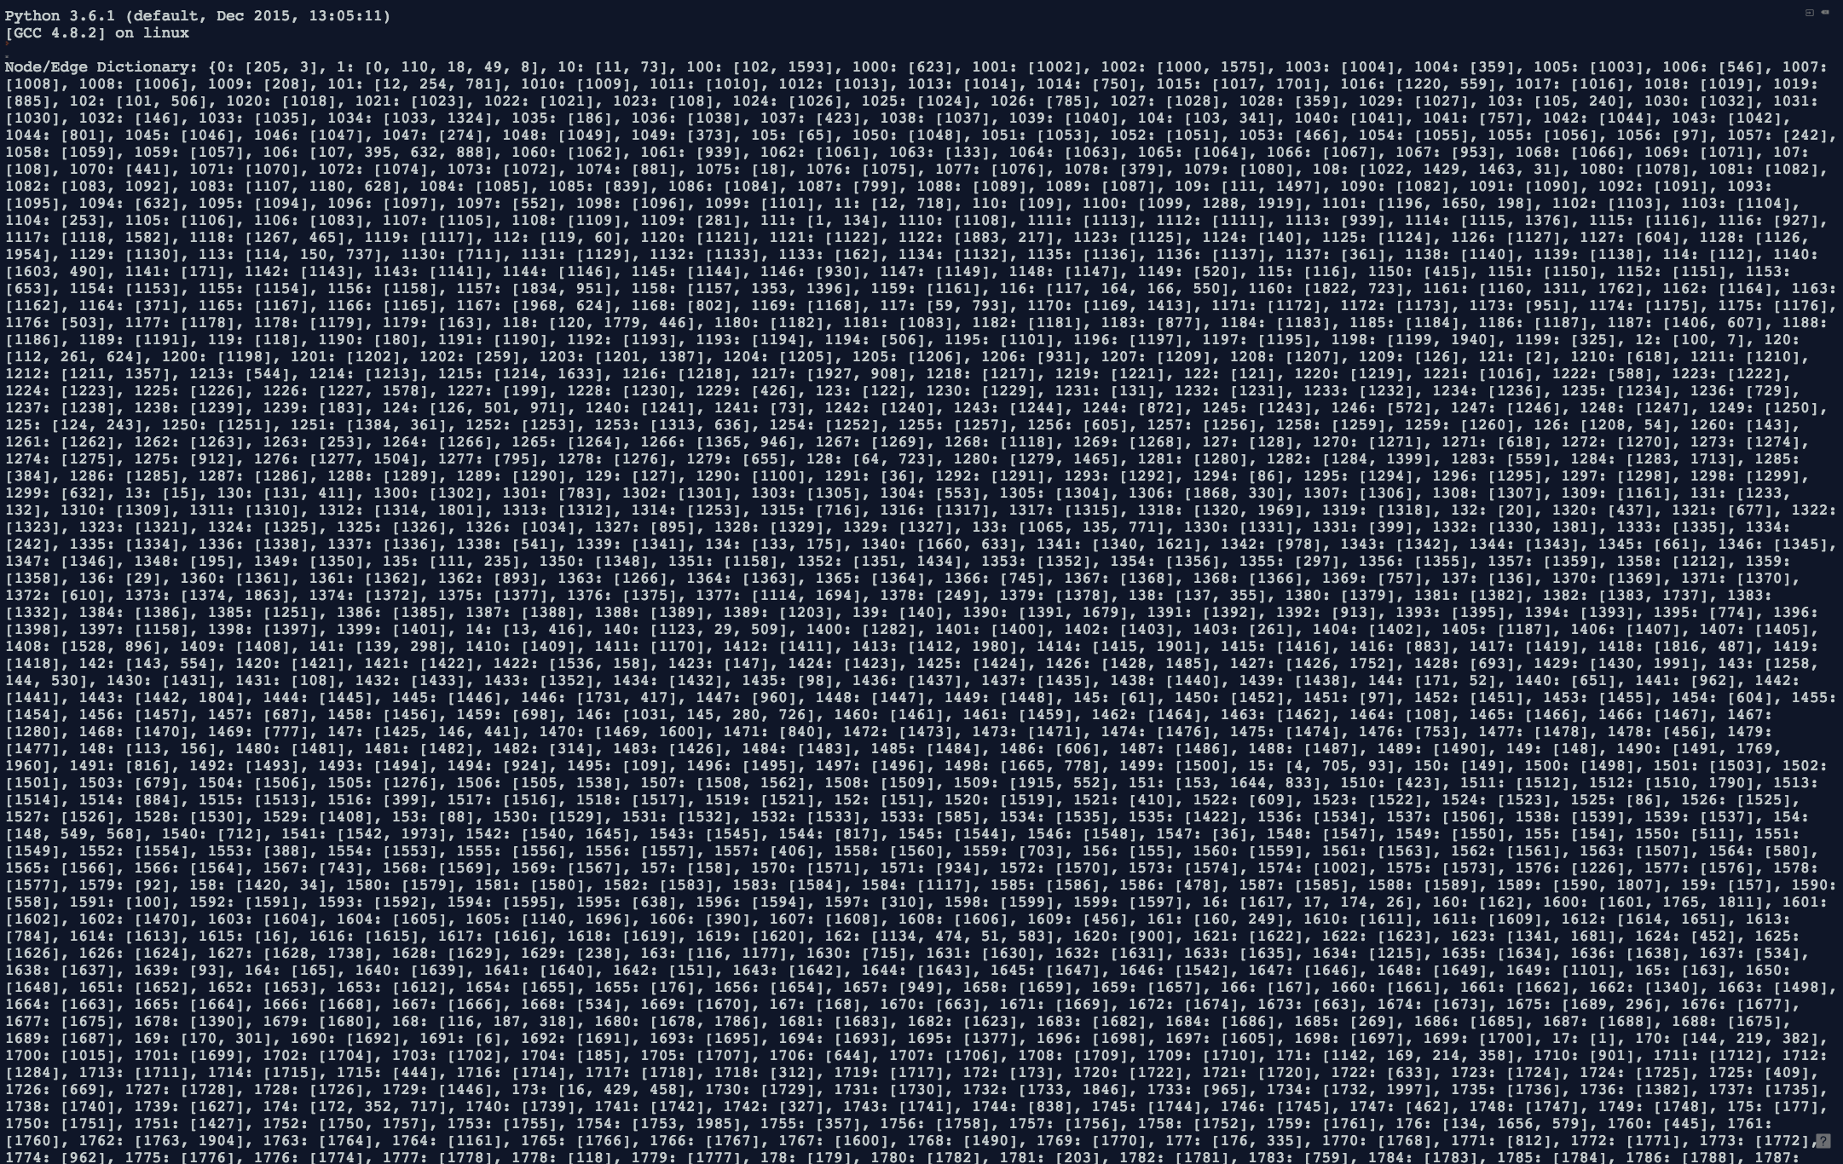
Data – example 2
2002 nodes, 2668 edges
➔ Too big!

Slide 7
Conclusions
Code works for small data sets
Ways to make it faster?
Instead of deleting path after new ‘current’
> Create sub-paths and combine with main cycle
Modify for genome subsequences

