Slide 1
Studying the Conservation of PinX1
Because a thesis was not enough

Slide 2
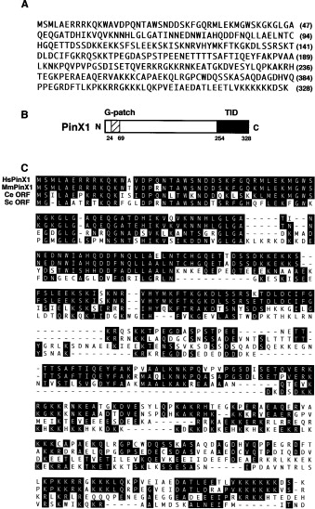
“PinX1 is conserved across many organisms..”
A sentence that would take me to war
(exactly what proteins look like)
Roughly: Is hPinX1 conserved, if so: where is it conserved?
Zhou and Lu 2011

Slide 3
Step 1: Project Planning
What I want:
How conserved is each amino acid among a sample of PinX1s
What I’ll do with it:
Does it roughly correspond to the domains in Zhou and Lu?
How I’ll get it:
Acquire a selection of PinX1 proteins from an online database
Create local alignments
Remove old alignments from sequences
Realign and get new score
What i’ll (hopefully) produce:
A graph showing relative conservation of each amino acid

Slide 4
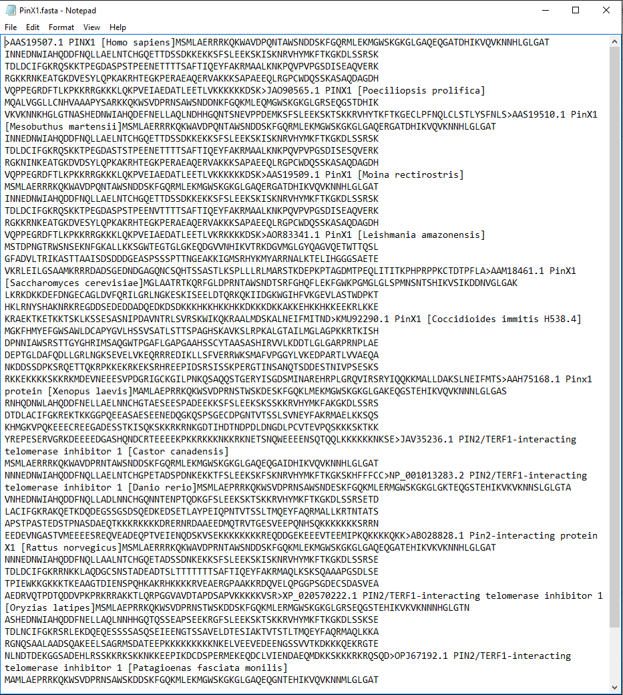
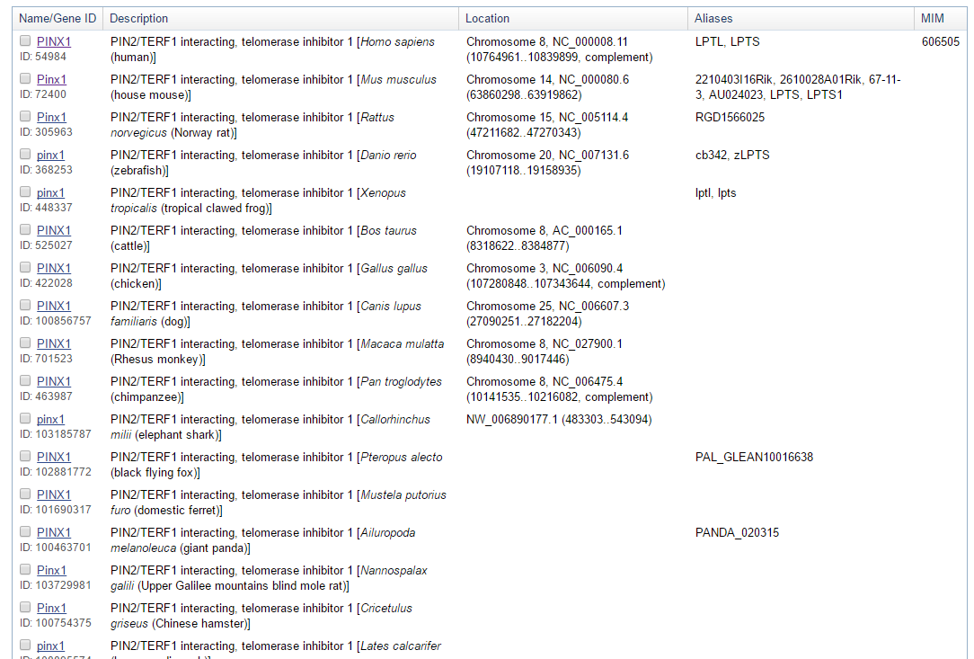
Step 2: Data Acquisition
Oh dear god
Look! Data is extant and nice!

Slide 5
Step 3: Program overall workflow
Labelled list of list containing each PinX1
Remove old alignment
.getFasta
Graph relative conservation
Local alignment of PinX1’s to human PinX1
Hacky nonsense black box turns FASTA into something a person could read
The scores are surprisingly high, some of them almost completely align already!

Slide 6
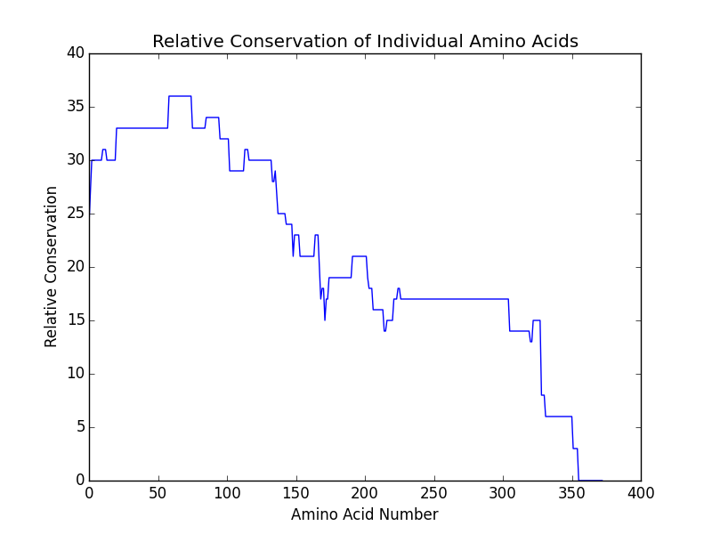
Results!
G-Patch is way more conserved than the Telomerase Inhibiting Domain
Telomerase Inhibiting Domain is somewhat conserved, so Janis was right (huge surprise)
TID
The “Business End”
G-Patch

