Slide 1
Finding Motifs in Restriction Enzyme Sequences
August Staubus
Bio 131

Slide 2
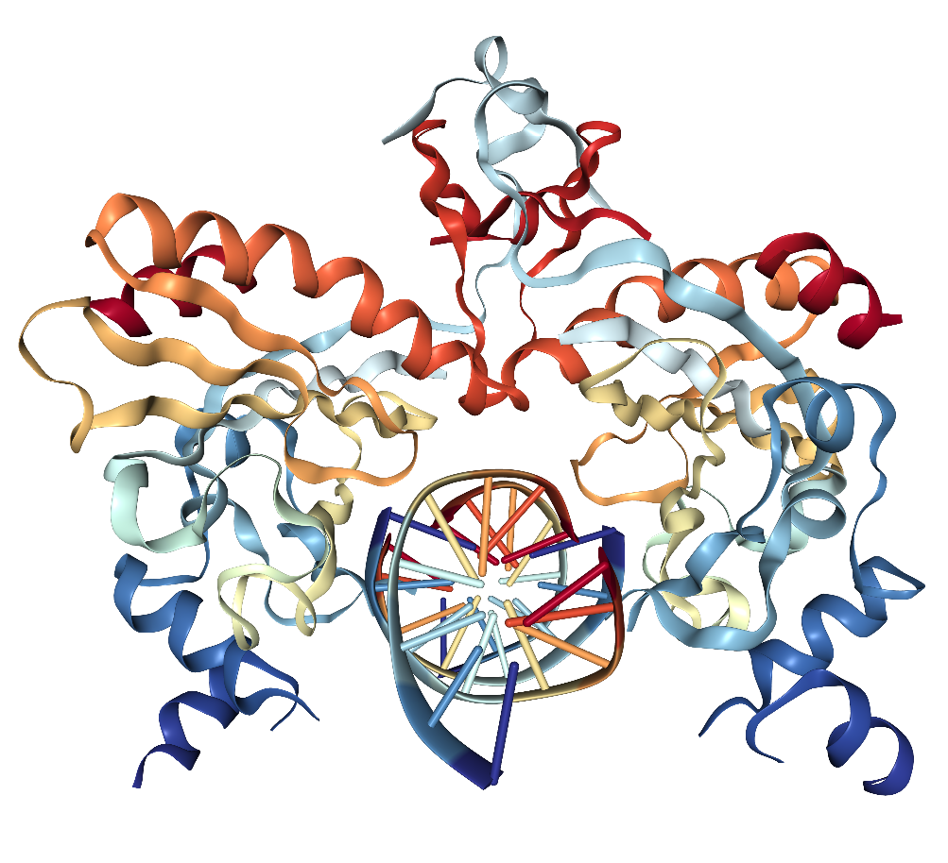
Restriction Enzymes
Cut DNA
160,337
Seemingly Unrelated
cengage.com
rcsb.org

Slide 3
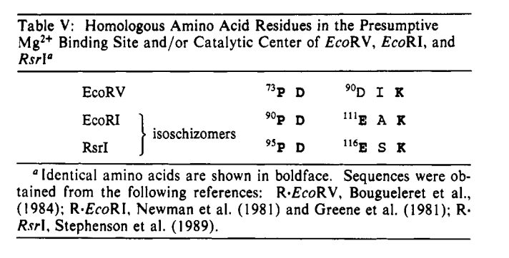
Motif!
Discovered by looking at structures
Thielking et al

Slide 4
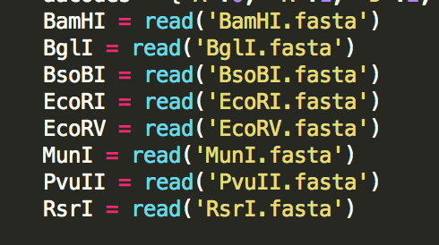
Data
Downloaded all 160,337

Slide 5
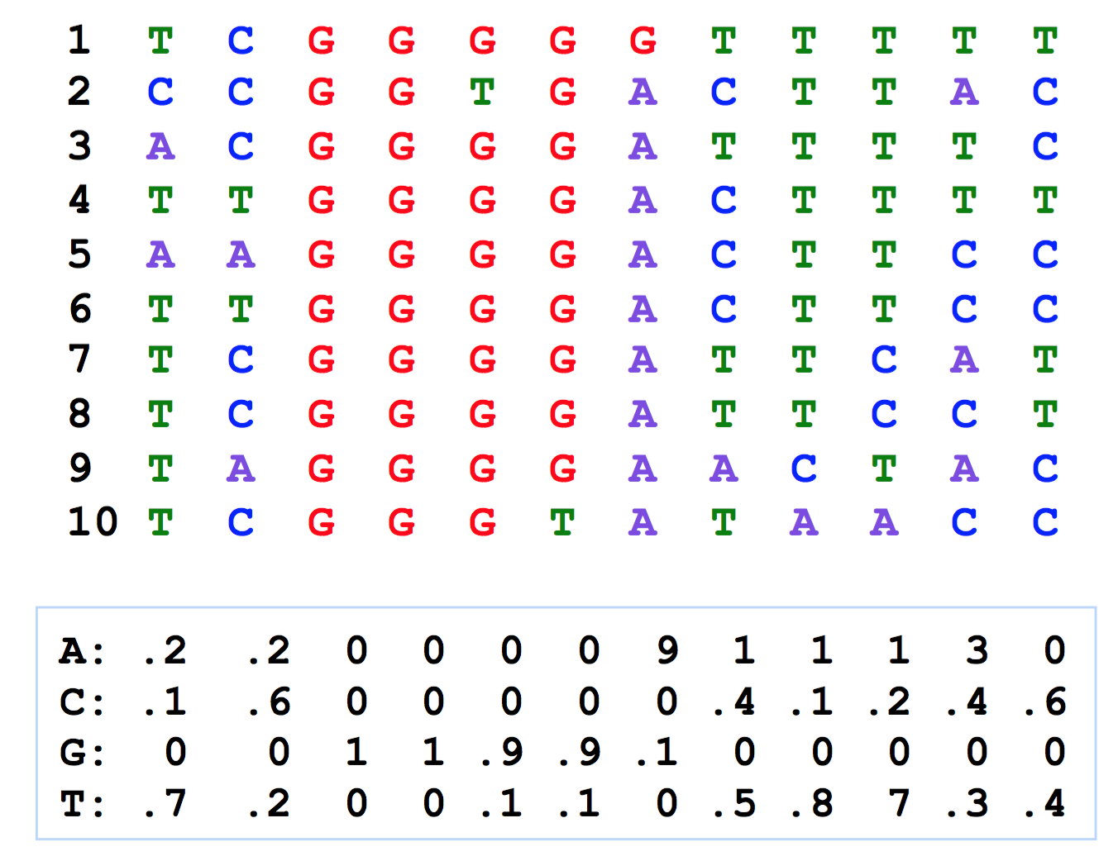
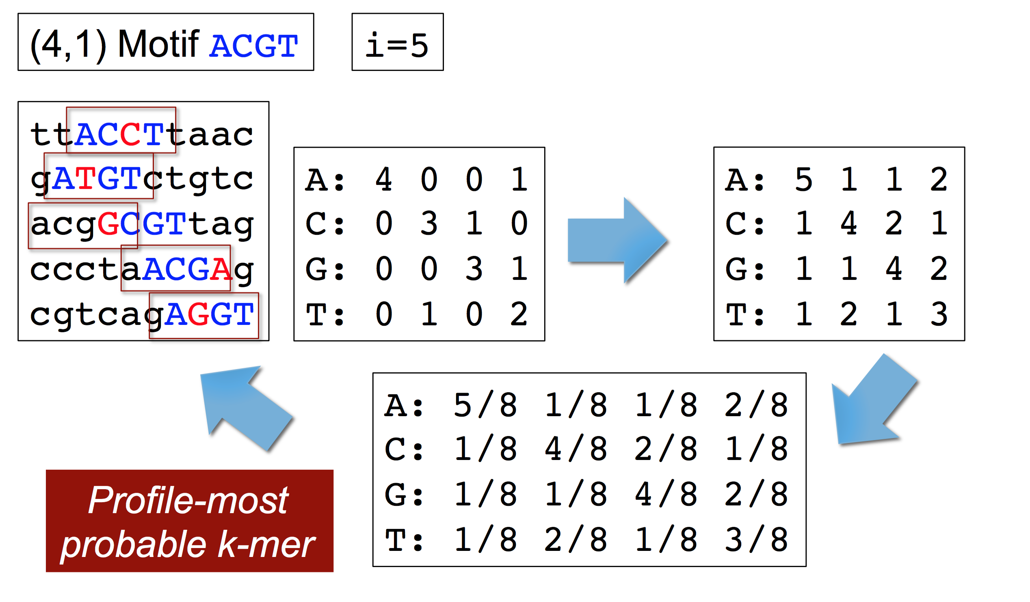
High-Level Code
Choose the first k-mer from the first protein sequence
  Compute a profile for this k-mer
Choose the profile-most-probable k-mer from the next protein sequence
  Compute a profile for the k-mers chosen so far
Compute the consensus of the selected k-mers
Compute the score of the selected k-mers
Ritz 2017
Repeat until the profile- most-probable kmer has been selected for each sequence
Ritz 2017

Slide 6
High-Level Code
Randomize the order of the protein sequences
Choose the first a random k-mer from the first protein sequence
  Compute a profile for this k-mer
Choose the profile-most-probable k-mer from the next protein sequence
  Compute a profile for the k-mers chosen so far
Compute the consensus of the selected k-mers
Compute the score of the selected k-mers based on amino acid mutation table
Repeat until the profile- most-probable kmer has been selected for each sequence
Repeat n times
Repeat i times
Ritz 2017

Slide 7
Results
Best 3-mer | Score | Best 2-mer | Score | Number of runs (i)
DLE | 8 | DE | 5 | 25
AND | 11 | FR | 5 | 50
RKG | 12 | HR | 5 | 100

Slide 8
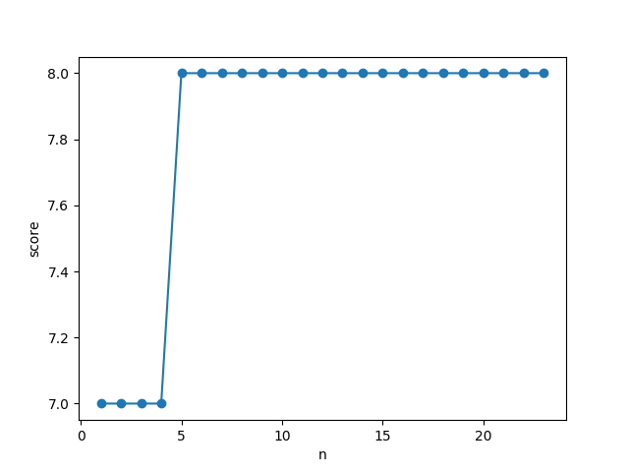
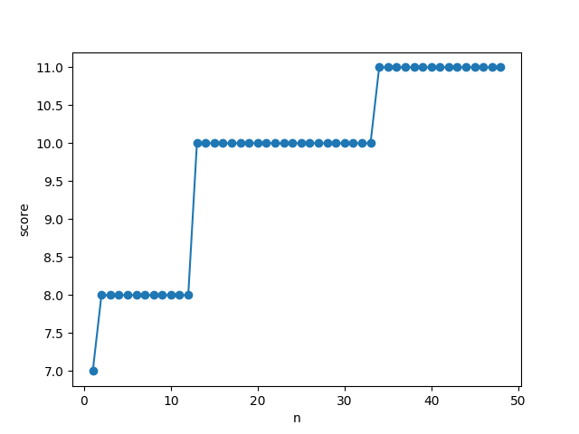
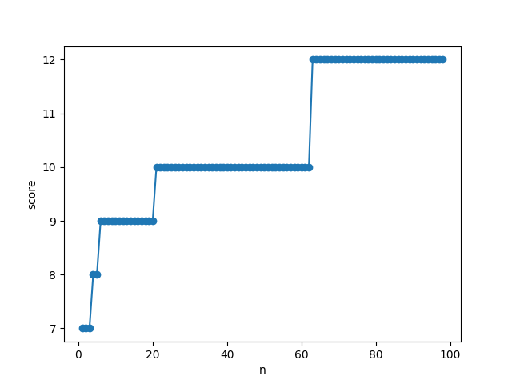
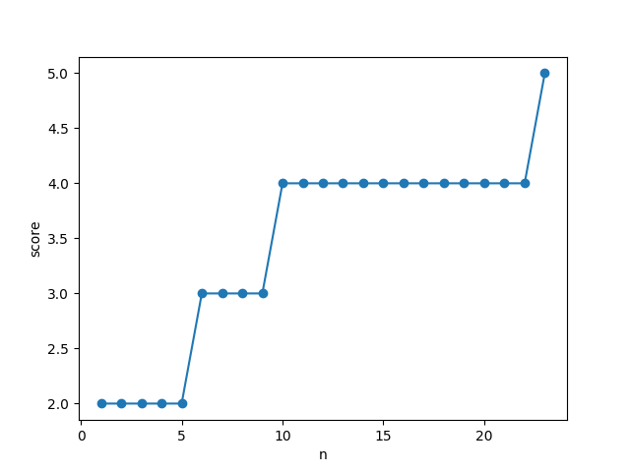
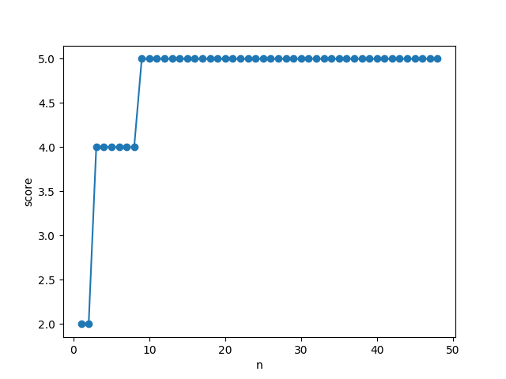
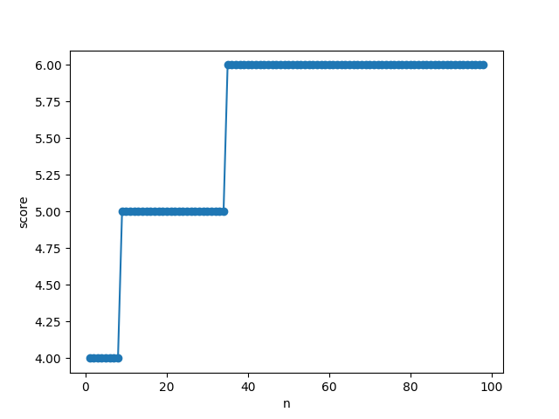
3-mer↑ ↓2-mer

