Slide 1
TELOMERASE BIOLOGY with A. burtoni
Measuring Identity with global alignment and affine gap penalties
By Allie Buckner

Slide 2
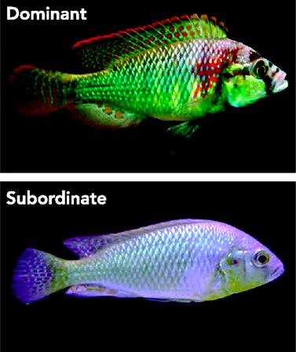
The problem
Telomerase is an enzyme that lengthens telomeres (the ends of your chromosome)
Low levels of telomerase have been linked to chronic stress in humans (Epel et al., 2004)
I wanted to measure telomerase activity in chronically stressed A. burtoni
How similar is A. burtoni’s telomerase to human telomerase?
Maruska, K., Fernald, R. (2011)
Notes:
This project piggybacks off of my thesis, which was focused on telomerase, the enzyme that lengthens the ends of your chromosomes and helps prevent the loss of important coding DNA during cellular replication. My thesis was inspired by a paper by Epel that showed that chronically stressed mothers had shorter telomeres and lower telomerase activity than age-matched mothers. Now this is interesting because your telomeres normally shorten as you age and telomerase activity goes down, but this study found that years of chronic stress can make your cells appear 9-17 years older than they were.
I wanted to see if this same phenomena could be seen in the highly social fish, A. burtoni. Dominant fish are known to have less cortisol than subordinates, meaning they are less stressed. So I compared the telomerase activity in dominant and subordinate individuals. The goal of my final project was to figure out if A. buroni’s telomerase is similar to human telomerase.

Slide 3
Methods
Get TERT peptide sequences from ncbi
Build Global Alignment with Affine Gap program
Calculate TERT protein identity from alignment
(identity = 100*matching amino acids/length of alignment)
Compare results to identity calculated by EMBOSS
Notes:
A paper by au et al. first proposed the japanese medaka as a model organism for studying telomerase biology. The japanese medaka is a close relative to A. burtoni. The way they did this was to compare the protein sequence of one of the components of human telomerase, hTERT, to TERT orthologs in zebrafish, medaka, and pufferfish. They did this using the program EMBOSS which calculates global alignment with affine gap penalty and computes percent identity, which is the total number of matching amino acids divided by the length of the alignment. Au et al decided that the medaka was a better organism for studying telomerase biology than the zebrafish and pufferfish because it had a higher identity to human telomerase than the other two. To determine if A. burtoni is as good or better than medaka for studying telomerase biology, I had to first get TERT peptide sequences from ncbi. Then build a global alignment program with the same affine gap penalties as EMBOSS and then use those alignments to calculate identity. Finally, I would compare the identities I calculated with Au et al’s results.

Slide 4
Program
Input: Two TERT protein sequences, gap open penalty, gap extension penalty, score dictionary
Output: The alignment of the sequences, the score of the alignment, the identity
Make 3 tables (T, M, B) and 3 backtrack tables (bT, bM, bB) with x rows and y col
T [0][0] and B [0][0]= -10000, M[0][0] = 0
For each row index i:
for each column index j:
if i = 0 and j >1: make first row of T = max(M[i][j-1]-indel, T[i][j-1]-extend), fill bT according to max
if i >1 and j =0: make first col of B = max(M[i-1][j]-indel, B[i-1][j]-extend), fill bB according to max
if i>0 and j>0: fill in B and bB same as above
fill in T and bT same as above
M = max(M[i-1][j-1]+score[string1[i-1]][string2[j-1]], T[i][j], B[i][j]), bM based on max
Backtrack while i>0 and j>0:
look at bM first, then jump to bT or bB if directed. bT means alignment1 = ‘-’+alignment1 and j = j-1
bB means alignment2 = ’-’+alignment2 and i = i-1
Notes:
Given two TERT peptide sequences, a gap open penalty, gap extension penalty, and scoring dictionary, the output is the alignment of the sequences, the score, and the identity. I used a gap open penalty of 10, extension penalty of .5, and the BLOSUM62 scoring dictionary because that’s what EMBOSS uses.
My program makes 3 tables for alignment scores and 3 backtrack tables.

Slide 5

Program
Input: Two TERT protein sequences, gap open penalty, gap extension penalty, score dictionary
Output: The alignment of the sequences, the score of the alignment, the identity
Make 3 tables (T, M, B) and 3 backtrack tables (bT, bM, bB) with x rows and y col
T [0][0] and B [0][0]= -10000, M[0][0] = 0
For each row index i:
for each column index j:
if i = 0 and j >1: make first row of T = max(M[i][j-1]-indel, T[i][j-1]-extend), fill bT according to max
if i >1 and j =0: make first col of B = max(M[i-1][j]-indel, B[i-1][j]-extend), fill bB according to max
if i>0 and j>0: fill in B and bB same as above
fill in T and bT same as above
M = max(M[i-1][j-1]+score[string1[i-1]][string2[j-1]], T[i][j], B[i][j]), bM based on max
Backtrack while i>0 and j>0:
look at bM first, then jump to bT or bB if directed. bT means alignment1 = ‘-’+alignment1 and j = j-1
bB means alignment2 = ’-’+alignment2 and i = i-1
Notes:
A score in the top table is the maximum of T i, j-1 minus .5, and M i, j-1 minus 10. The same pretty much happens for the bottom table. The middle table is the maximum of the top and bottom scores, and Mi-1,j-1 plus the score or penalty of matching the amino acids from the two strings
It fills out the score of the first row of the top table, then the first column of the bottom table. It then fills out all of the middle I’s and j’s beginning with the bottom table, then the top table, then the middle table.
Every time you make a choice, the backtrack table for that table is filled depending on the choice you made.
The backtrack program runs until it reaches 0, 0 by beginning with the bottom right corner of the middle table then following the middle table until it tells you to move to the top or bottom backtrack table.

Slide 6
For i in length of alignment:
if amino acid in alignment1[i] = amino acid in alignment1[i]
add 1 to total number of matching amino acids
Identity = 100*matching amino acids/length of alignment
Notes:
Identity is calculated by first figuring out the number of total matching amino acids. If the two alignments match then you add one to the total number of matching amino acids. Identity is the percent of matching amino acids to the length of the alignment.

Slide 7
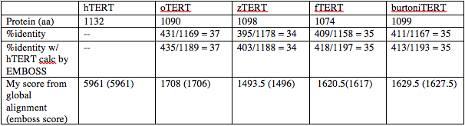
Results
My program calculated roughly the same percent identity and scores as EMBOSS
Burtoni TERT is 35% identical to hTERT, not as good as medaka (oTERT)
Burtoni may still be a good choice for studying social stress and teloemrase
Can use this program to calculate identity for future TERT research
Notes:
The percent identity EMBOSS calculated for medaka and hTERT was 37%, which is the same as the identity I calculated for medaka. I also checked my program against EMBOSS with pufferfish (fTERT) and zebrafish (zTERT). Because they were the same, I took that to mean that my program was good. The slight variation in alignment scores is likely due to different ways of calculating ties.
I calculated that burtoni TERT is 35% identical to hTERT, which is not as good as medaka, but pretty close.
That doesn’t mean that you can’t use a burtoni to study telomerase, it just means that you need to be careful before extrapolating findings to humans. More is known about burtoni social structure, so it might still be a better choice when researching social stress and telomerase.
This program can also be used to compare sequence identity for other organsims’s TERT proteins for future telomerase research.

Slide 8
References
Au, Doris W.T., Helen O.L. Mok, Lynne W. Elmore, and Shawn E. Holt. 2009. “Japanese Medaka: A New Vertebrate Model for Studying Telomere and Telomerase Biology.” Comparative Biochemistry and Physiology Part C: Toxicology & Pharmacology 149 (2): 161–67.
Epel, E., E. Blackburn, J. Lin, F. Dhabhar, N. Adler, J. Morrow, and R. Cawthorn. 2004. “Accelerated Telomere Shortening in Response to Life Stress.” Proc. Natl. Acad. Sci. U. S. A. 101 (49): 17312–15.

