Slide 1
Comparing Mitochondrial DNA
Mina Marden

Slide 2
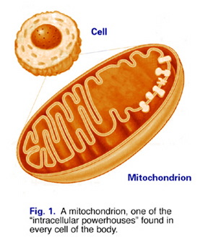
Mitochondrial DNA

Slide 3
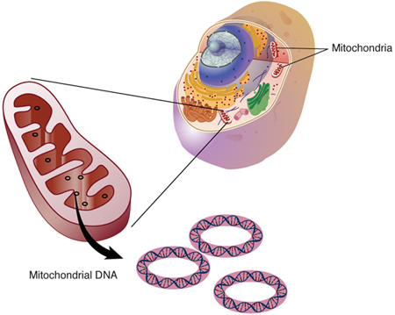
Mitochondrial DNA
Entire genome: 3.0x10⁹ bp
Mitochondrial genome: 16,569 bp

Slide 4
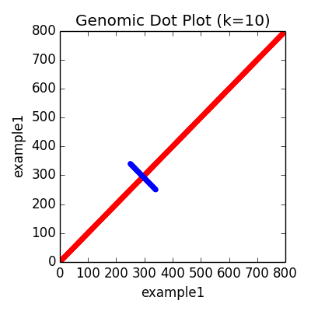
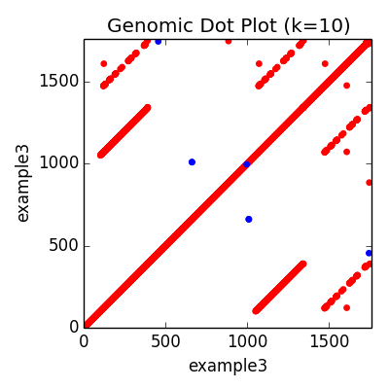
How I compared it…

Slide 5
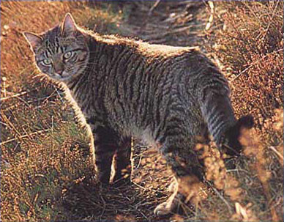
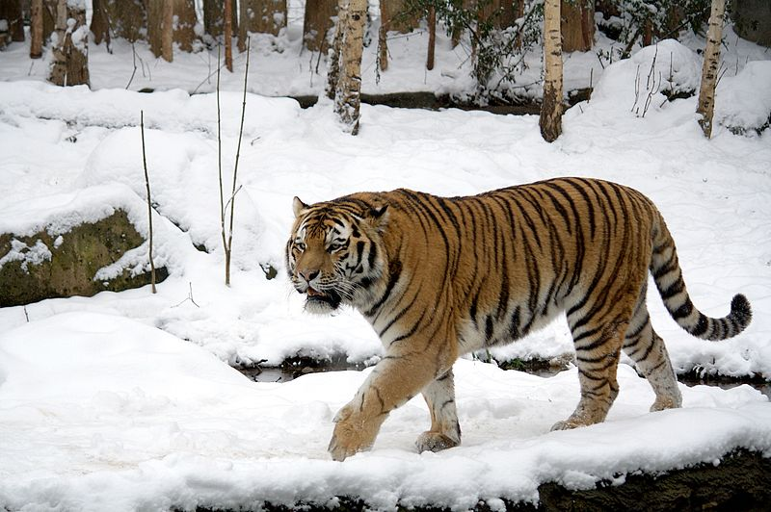
Which mitochondrial genomes?
Felis catus
Panthera tigris

Slide 6
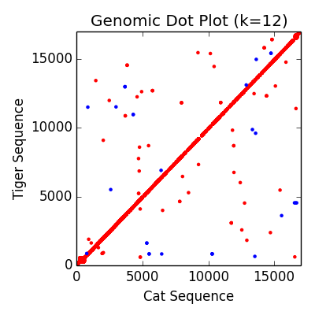
Results!
Forward matches: 9386
RevComp matches: 29

Slide 7
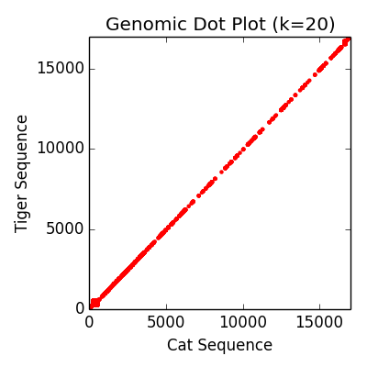
Results!
Forward matches: 5739
RevComp matches: 0

Slide 8
Results!
Forward matches: 9386
RevComp matches: 29
Forward matches: 5739
RevComp matches: 0

Slide 9
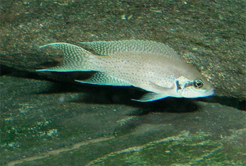
Another comparison!
Felis catus
Neolamprologus brichardi

Slide 10
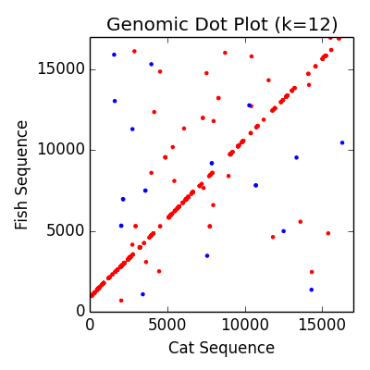
More results
Forward matches: 497
RevComp matches: 21

Slide 11
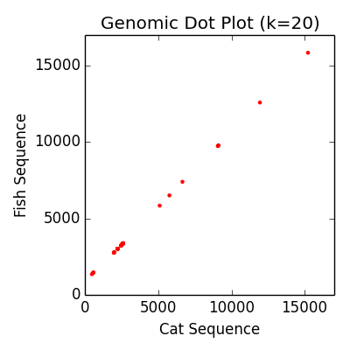
More results
Forward matches: 98
RevComp matches: 0

Slide 12
More results
Forward matches: 497
RevComp matches: 21
Forward matches: 98
RevComp matches: 0

Slide 13
Clearly…
Forward matches: 5739
RevComp matches: 0
Forward matches: 98
RevComp matches: 0

Slide 14
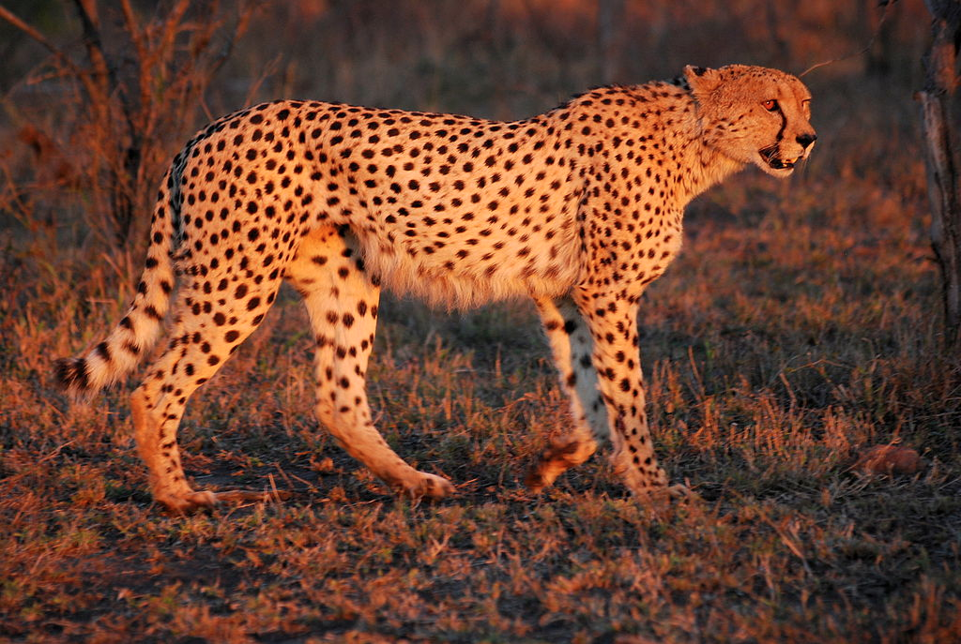
So what about cheetahs?

Slide 15
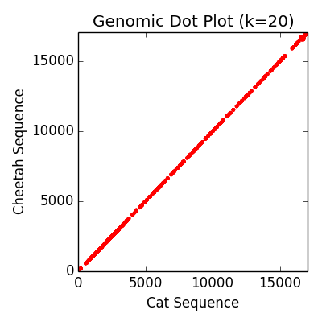
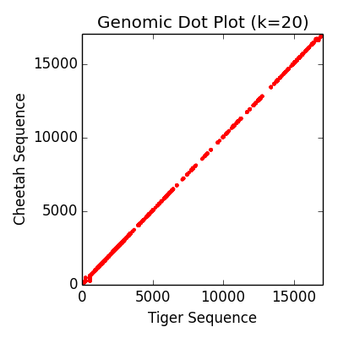
So what about cheetahs?

Slide 16
So what about cheetahs?
Forward matches: 3474
RevComp matches: 0
Forward matches: 2491
RevComp matches: 0

Slide 17



