Slide 1

Identification and Characterization of pre-miRNA Candidates in the C. mitchellii Genome
Notes:
I have compiled a library of candidate microRNA sequences in the C. mitchellii genome and analyzed these sequences based on the secondary hairpin structures of their pre-miRNA, then created plots that can be used to analyze this data based on several key parameters.

Slide 2
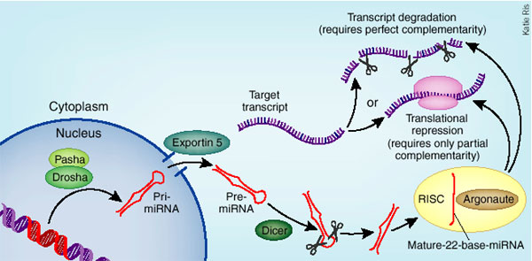
Why look for miRNAs?
Notes:
transcribed but never translated, form stem loop structures
MicroRNAs bind to complimentary seed sites in mRNA in order to block translation or fate the mRNA for destruction
Regulation of many biological pathways
Important for understanding genome function

Slide 3
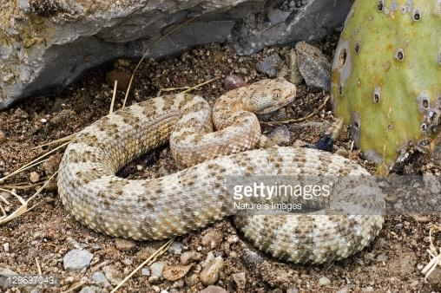
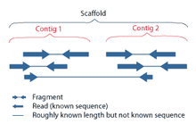
Can I identify clusters of candidate miRNAs in the C. mitchelli genome?
C. mitchelli (rattlesnake)
Notes:
whole genome shotgun sequence of C. mitchelli assembled in 2013 was obtained from the NCBI genome database.
consists of 473,380 contigs, the 50 longest contigs were converted to text files
analysed for possible miRNA sequences.

Slide 4
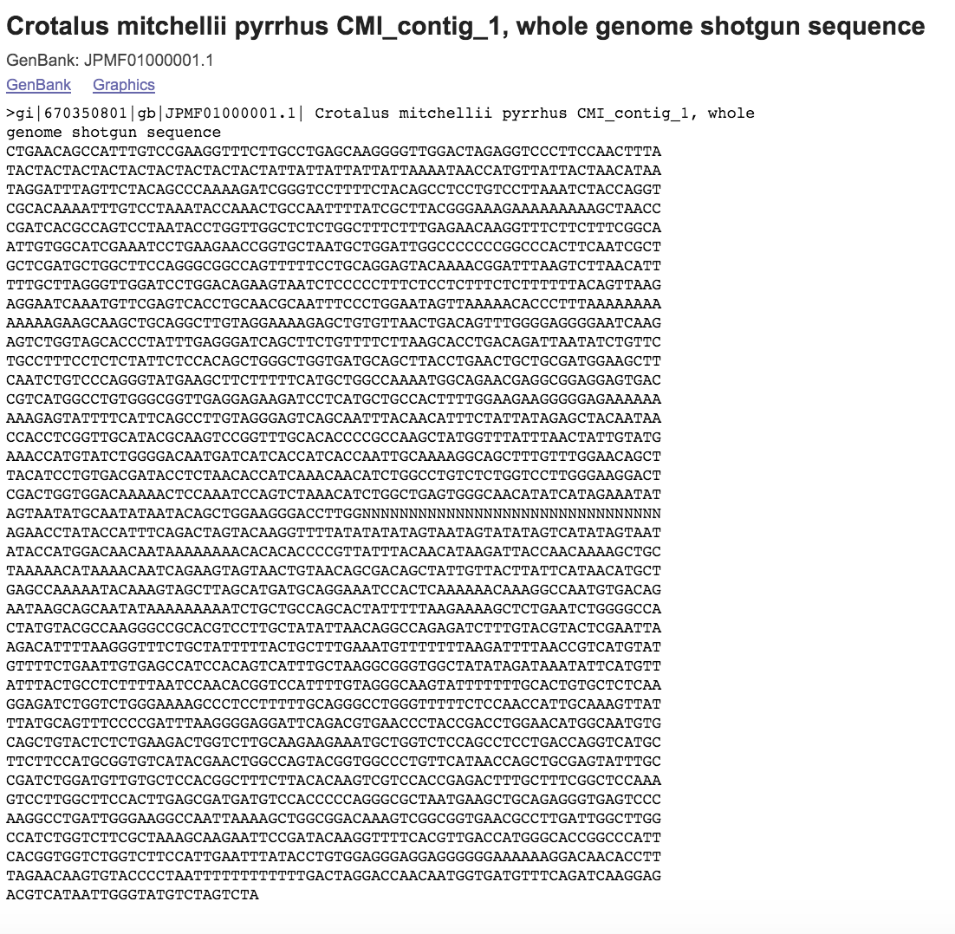

Slide 5
The Approach
Candidate miRNA info for each contig
miRNAFold
Notes:
Candidates were identified using miRNAFold, an Ab initio miRNA prediction tool.

Slide 6
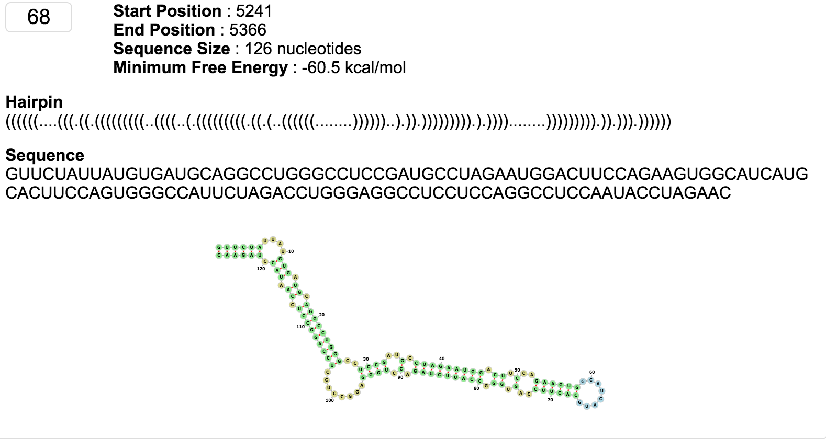
miRNAFold: an Ab initio miRNA prediction tool
Notes:
output of this program contains the start and stop position on the contig, the size of the miRNA sequence identified, the minimum free energy of the structure, the RNA sequence and two visual representation of the stem-loop structure

Slide 7
The Approach
Candidate miRNA info for each contig
miRNAFold
Text files
Notes:
The result files containing all candidate miRNA data for each of the 50 contigs were manually converted to text files for further computational processing.

Slide 8

The Approach
Candidate miRNA info for each contig
miRNAFold
Text files
Notes:
program stores the text files containing the information for candidate miRNA information into a dictionary and then creates four line plots for each contig which map the miRNAs
first part of my program was made in collaboration with Elaine Kushkowski
The first step of the program is to import a text file with a list of the contig numbers, which is used to open each contig text file (OpenFile function).
Then, for each contig our program stripped the miRNAFold output files of all unnecessary information
stored all candidate miRNA information in a dictionary for each contig.
Contig dictionary refined by minimum free energy threshold of miRNA hairpin structure

Slide 9
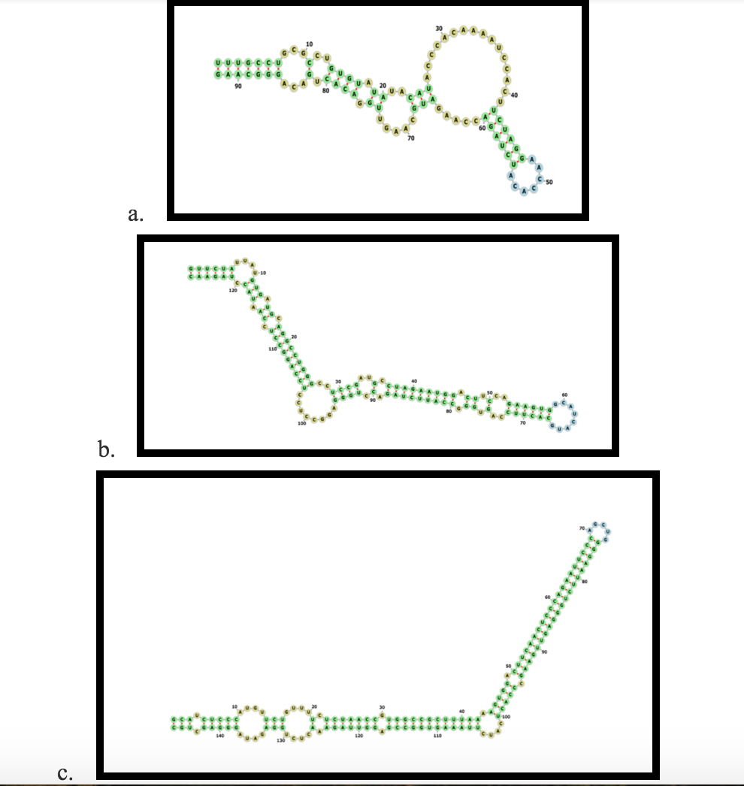
Candidate miRNAs library can be altered based on threshold free energy
Notes:
Examples of candidate miRNA sequence identified based on secondary hairpin structures from C. mitchellii genome
minimum free energy values of (a) -20.1 , (b) -60.5 and (c) -96.3 kcal/mol . Candidates were identified using the Ab initio miRNA prediction tool miRNAFold.
Green nucleotides represent a complementary Watson-Crick base pairing in the stem, yellow nucleotides represent non-paired segments in the stem, and the blue nucleotides represent the sequence that make up the loop structure.
Shows various levels of stability (bottom most stable)

Slide 10
The Approach
Candidate miRNA info for each contig
miRNAFold
Text files
Free Energy
-60 kcal/mol
Notes:
candidate miRNA dictionaries were then refined to exclude miRNAs that do not fall below a threshold free energy value, which is set manually in the main function (lowest_freeEnergy function).
purpose of this function is to be able to exclude miRNAs that have a high free energy and are unstable.
narrowed candidate miRNA dictionaries where then stored in an outer dictionary by contig number (makeDictionary function)
gives us a dictionary of dictionaries where the miRNA sequences and associated information such as starting indices, ending indices, and free energy are stored according to contig number and starting index keys.

Slide 11
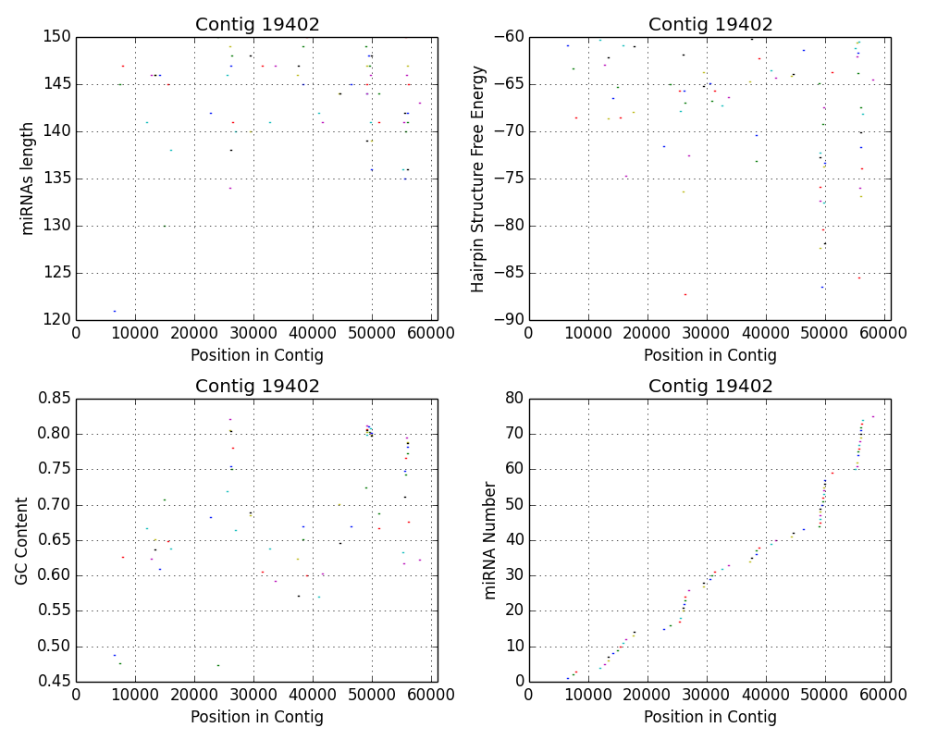
The Approach
Candidate miRNA info for each contig
miRNAFold
Text files
Free Energy
-60 kcal/mol
Plotting
Notes:
second part of the program was done individually
For each contig in the dictionary, all candidate miRNAs with a free energy value below -60 kcal/mol were plotted by starting and stopping indices on a line plot.
Four plots were created for every contig, one plotted against length of miRNA sequence, one plotted against the free energy value of the miRNA, one plotted against the GC content of each miRNA and one plotted against the miRNA number (Plotline function).

Slide 12
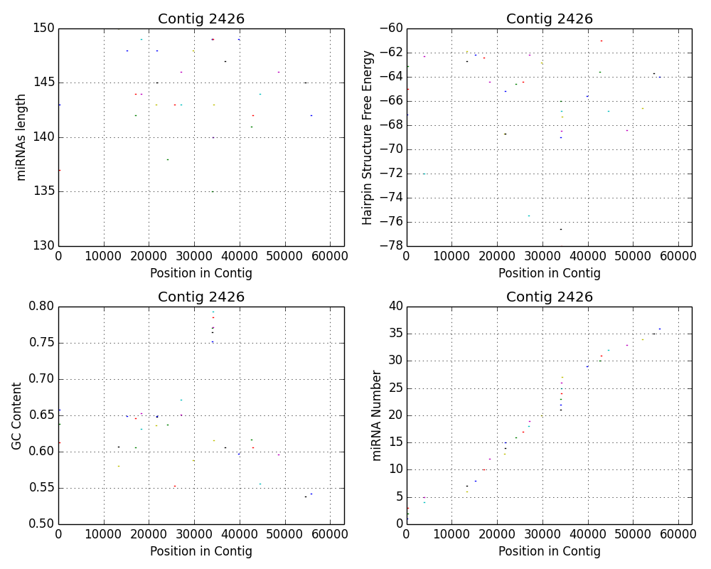
Notes:
Contig 2426 shows a cluster of candidate miRNAs around 33,000.
this cluster has an especially high GC content (0.75 – 0.8) compared to the rest of the miRNAs, and to this section of the genome as a whole (which has a GC content of 0.67).
This same cluster has similar lengths and hairpin free energies, which implies that in the GC rich region of the contig, the region that overlaps between all the miRNAs in the cluster forms a stable stem loop structure.

Slide 13
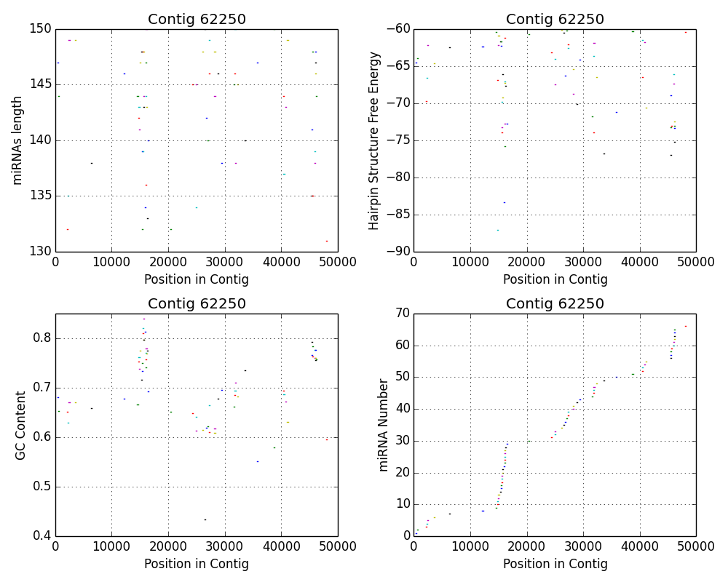
Notes:
A similar trend is seen in contig 62250
has two very distinct candidate miRNA clusters and several smaller, more dispersed clusters
The miRNAs in the cluster around 15,000 have a GC content above 0.7, but vary greatly in length and free energy.

Slide 14
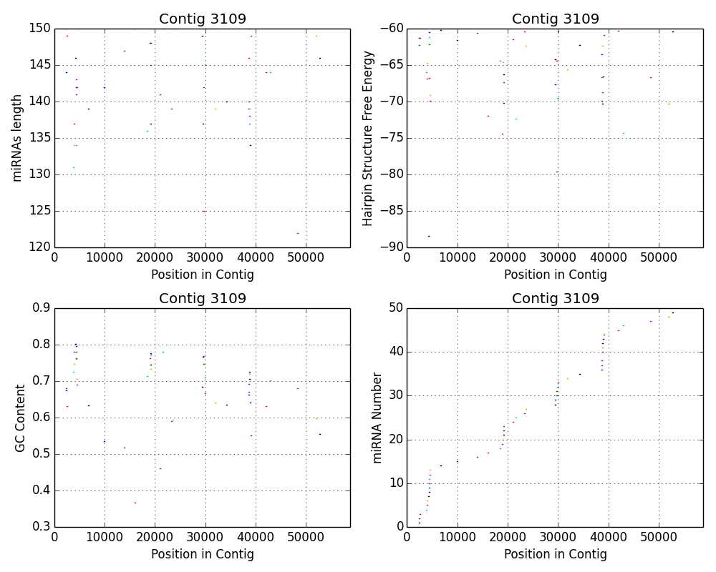
Notes:
Contig 3109 shows four distinct clusters of miRNAs.
This trend is especially apparent on the miRNA number graph, which shows verticle clusters in those regions.
These clusters have overlapping regions, but vary widely in length and GC content. Within clusters, their hairpin structure energies are relatively similar.
These candidate clusters imply that there is likely a very stable hairpin structure in the overlapping region of each of these clusters.
This may imply that theses hairpin structures are more likely to be pre-miRNAs.

Slide 15
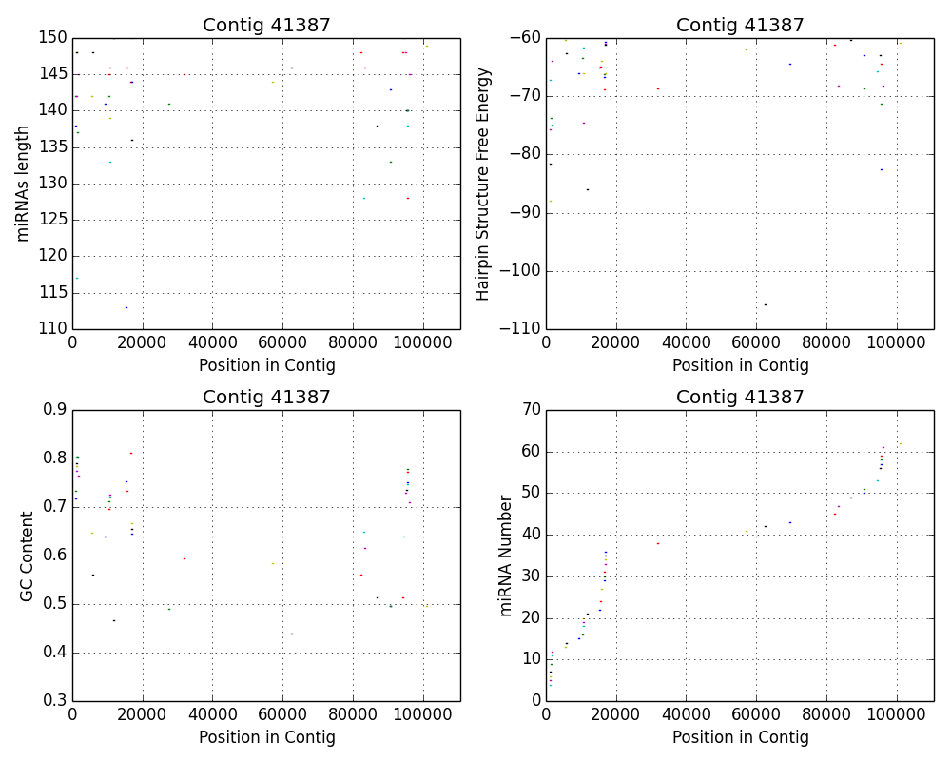
Notes:
The previous three contigs all contained many candidate miRNAs, but many of the contigs contained few if any candidate miRNAs. Contig 62250 contains few miRNAs, but shows a distinct clustering of the candidates that were identified within it. MicroRNAs are commonly located in clusters throughout the genome, as more than one miRNA may be expressed from the same primary miRNA transcript (pri-miRNA), and the clustering observed in this contig follows this pattern.
From this data alone, we cannot putatively identify any sequences, but rather provide a starting point for future miRNA identification. Hairpin structure alone is not enough to assign any sort of identification to these sequences, and limiting our results by free energy of these structures may actually exclude possible pre-miRNAs that meet other criteria.
this data is based on an analysis of only 0.3% of the C. mitchellii genome, so running this program on more of the contigs could reveal important trends in candidate miRNA distribution.
a location based approach to analyzing this dictionary of candidates would narrow results and identify clusters. In the future, once the C. mitchellii genome is annotated, our list of candidate miRNAs can be further refined to those that fall outside the protein coding region.

