Slide 1
Comparing Crosslinkers
Mari Cobb
Intro to Computational Biology Final Project

Slide 2
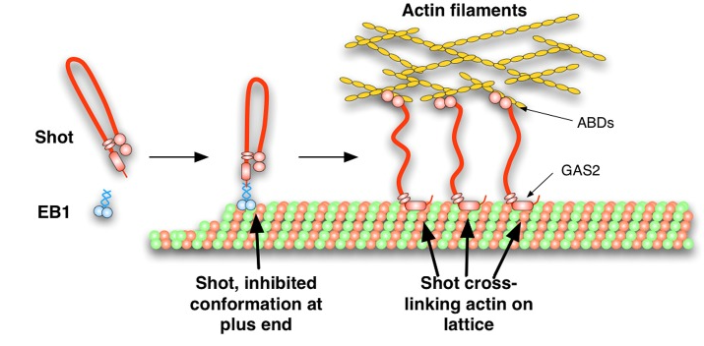
Cytoskeletal Crosslinkers
Connect actin to microtubules.
Important for cellular organization and possibly for cell migration.
Protein sizes differ wildly.

Slide 3
Motivation and Goals
Compare crosslinkers in different organisms to see how similar they are.
Obtain global alignment scores and local alignment scores comparing various crosslinkers to a human crosslinker.
Draw an evolutionary tree based on collected data.

Slide 4
How I did this
Got FASTA files for ACF1 (Human), MACF7 (Mouse), BPAG1 (Mouse), and Short Stop (Fruit fly).
Computed pairwise local and global alignments with Python.
Computed percentages of matches by dividing the number of total matches in an alignment by the total number of nucleotides that were being aligned.

Slide 7
23.6%
25.2%
0.04%

Slide 8
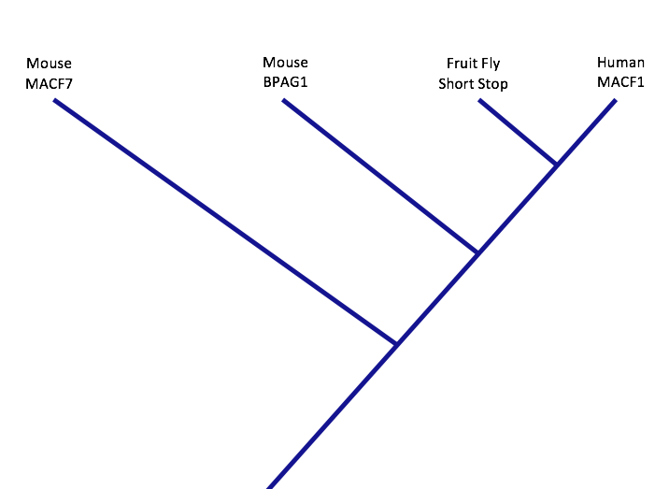
Phylogenetic tree

Slide 9
What went wrong
The local alignment scores were always the same, or close to the same value, as the smaller of the two sequences to be aligned.
The lengths of the proteins were really different.
      ACF1 (Human) = 17701 nucleotides
      MACF7 (Mouse) = 2860 nucleotides
      BPAG1 (Mouse) = 5452 nucleotides
      Short Stop (Fruit fly) = 16798 nucleotides
These FASTA files may not have been optimal.

Slide 10
Thank you

