Slide 1
Rearrangement vs. Point Mutations
By Karl Menzel

Slide 2
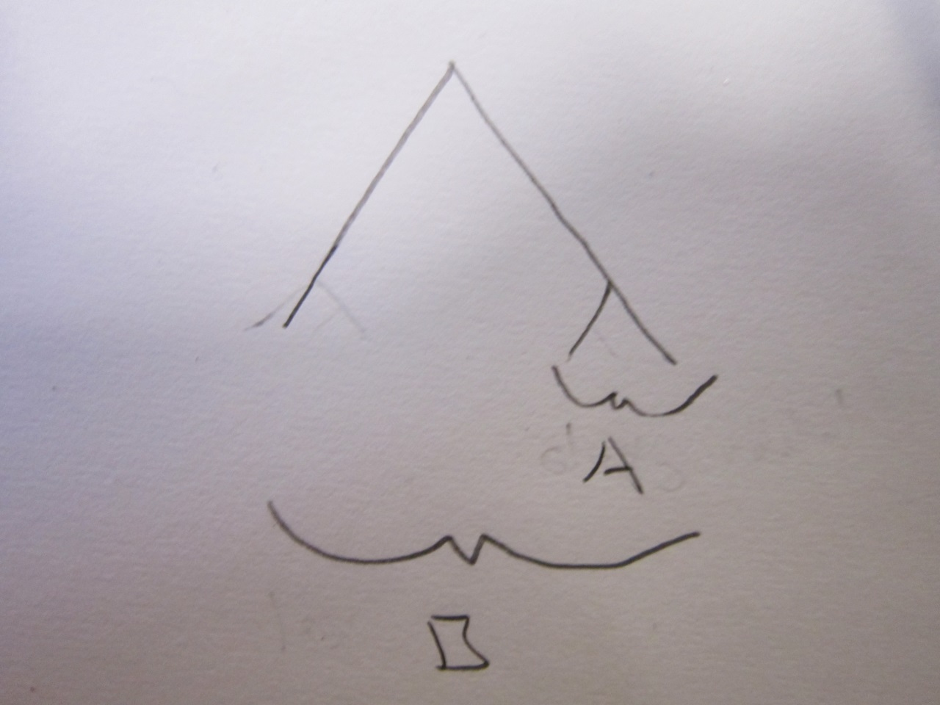
Is rearrangements or Point Mutations Faster

Slide 3
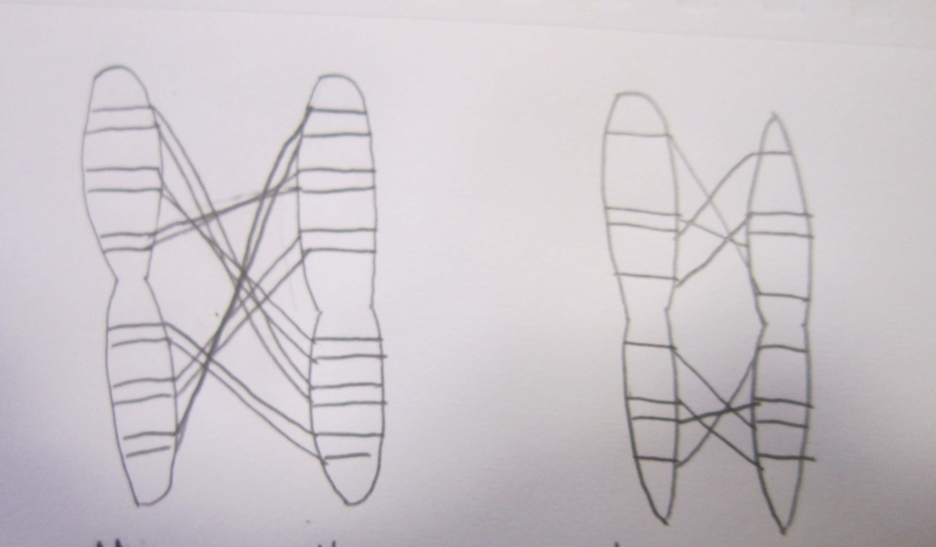
Synteny Blocks and Chromosomes
Mouse Human
Chimp Human

Slide 4
Data Reading and Sliding Window

Slide 5
Results
 | Human vs Chimp | Human vs Mouse
Rearrangements | 1 | 10
Alignment Coverage | 67.5%

Slide 6
Discussion
Need More Time and Data
Next Steps:
Affine Gap Penalty
Maybe Look at specific Genes

