Slide 1
Alternative splicing: Sequence Alignment with Affine Gap
Erin Howell

Slide 2
Alternative Splicing:
Identifying alternative splicing sites with an alignment
Look for patterns in gene splicing
Use affine gap to identify splice sites
Data
ATF3
PCDH15

Slide 3
Layout and associated problems:
Filling pattern
Backtracking design
Weighting
Prioritization

Slide 4
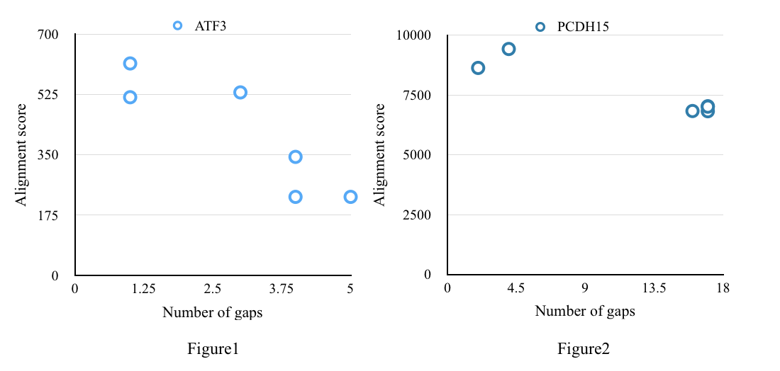
Discussion:
Alternative alignment varies a lot
What constitutes a meaningful result?
Weighting and organization have a HUGE impact on alignment
Future: splicing between species?

Slide 5
Sources:
UCSC Genome Browser search for
ATF3 (Homo sapiens activating transcription factor 3 (ATF3)
PCDH15 (Homo sapiens protocadherin-related 15 (PCDH15)
Downes, S. (2004). Alternative splicing, the gene concept, and evolution. History & Philosophy of the Life Sciences, 26(1), 91-104. Retrieved December 15, 2015, from http://0-www.jstor.org.catalog.multcolib.org/stable/23333382

