Slide 1
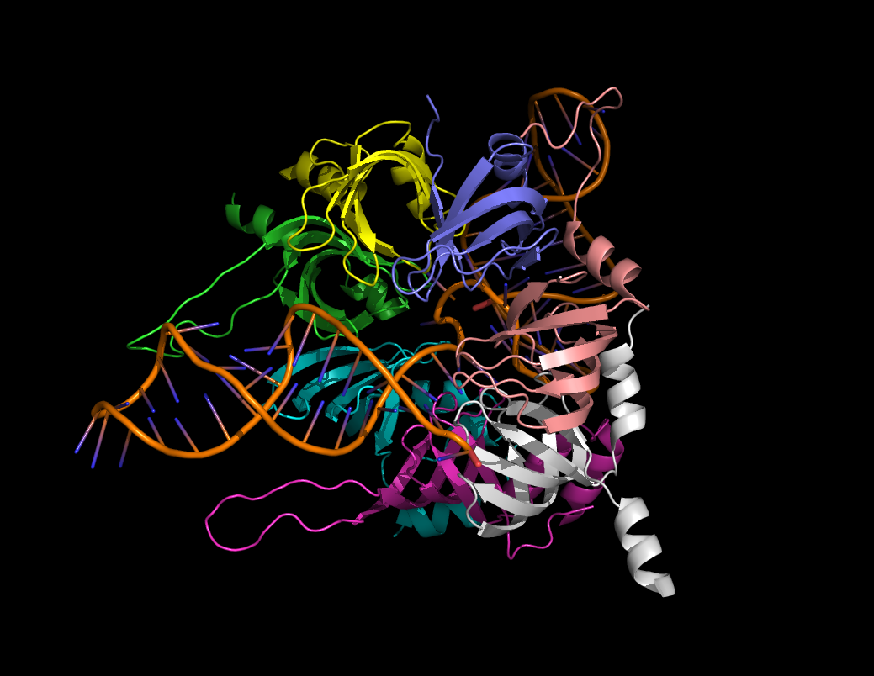

Slide 2
Finding splice sites
With particular interest given to the inhibitory dopamine receptor gene (D2)

Slide 3
What’s the problem? How did I solve it? What did I find?
Would you like to know more?

Slide 4
Pre mRNA needs to get cut in an ordered fashion
So splicing elements cue splicing factors to splice.
This can be regulatory

Slide 5
Alternative splices of pre mRNA
The same gene can code for several different proteins
This must be signaled in some way
Looking for the specific elements involved in this could indicate mechanism.

Slide 6
The problem:
Given a gene, a set of known splicing elements, and a set of known splice sites, output the splicing elements found within a given range of the sites in the gene
Do it in a way which is interpretable

Slide 7
The data:
The D2 gene entry on genbank in fasta form
A database of splicing factors with details including splicing element, known target gene, organism, etc.
Splice sites from the genbank entry on the D2 gene (cut and pasted… I know, so lame.)

Slide 8
The solution:
My program!
Dictionaries for days
A look up function which can be used to look up the results and output what they might mean
Not that complex, but there is just so much you might want to be able to do… making all of that possible and still generating something useful is what gets hard.

Slide 9
More details you ask?
Split the genome up into sections of a given range by splice site
Look for each motif in the data set in each section
Output a dictionary of dictionaries
Dict. Of Splice sites
Dict. of found motifs
List of locations of hits
Look up the found motifs and output something more interesting
Turn the data set into a dict. of dict. of catagories
Look up the specific category of the specific motif and output the value
Yay! Profit!

Slide 10
A brief history of D2
Inhibitory dopamine receptor involved in negative feedback loop behind cocaine tolerance in the midbrain
Long and short form alternative splicing factors (exon 6 is variable)
Alternative splicing implicated in tolerance response.

Slide 11
Nothing obviously different about 6th exon splice sites…
But… Wait for it:

Slide 12
Something cool!! (maybe)
GluR2 receptor also implicated in cocaine tolerance
Splicing elements which have been observed in alternative splicing of GRIA2 gene are present near most of the D2 splice sites
This is not a likely occurrence.

Slide 13
So maybe…
The same protein or set of proteins is responsible for both the D2 and GluR2 responses to cocaine
Vuala. Science is true.

