Slide 1
Pinx1
Sequence and Structural Comparisons of PinX1 Across Species
Ajit Elhance

Slide 2
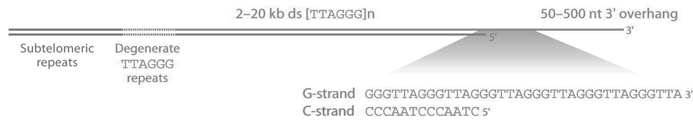
Telomeres
Telomeres are long strings of short tandem repeats (TTAGGG in mammals) found at the ends of chromosomes
Telomeres protect the ends of DNA from regular degradation that results from the “end replication problem”
Telomerase extends telomeres
Many cancers upregulate telomerase, enabling immortalization of cells
Proper maintenance and regulation of telomere length is thus vital for proper cell function

Slide 3
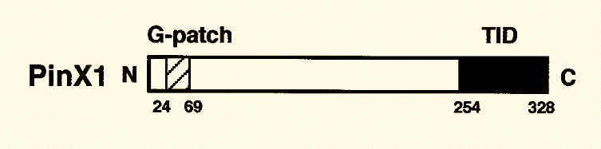
Pin2/TERF1-interacting protein (PinX1)
Telomerase Inhibitor (Zhou & Lu, 2001)
Potential tumor suppressor
PinX1 contains a Glycine-rich domain at the N-terminal and a telomerase inhibitory domain at the C-terminal
Experiments with truncated versions of PinX1 found that only the C-terminus was involved in telomerase inhibition
PinX1 orthologs exist in many species such as mice and frogs

Slide 4
The Question:
In-vitro cross-species inhibition effect (Condon, 2013)
TRAP assay inhibition (Zhou & Lu, 2001, Cylinder 2012)
In-vivo experiments (Shampay, unpublished results)
Structural predictions via circular dichroism (Posert, 2014)
Does sequence alignment and analysis reveal any insight into the potential cross-species inhibition effect of PinX1 on telomerase?

Slide 5
The Approach
DNA sequence alignments:
Python: Global DNA sequence alignment
hPinX1 vs. mPinX1
hPinX1 vs. xPinX1
mPiNX1 vs xPinX1
Amino acid sequence alignments:
Python: Global AA sequence alignment
hPinX1 vs. mPinX1
hPinX1 vs. xPinX1
mPinX1 vs. xPiNX1
PSIPRED secondary structure comparisons:
Comparing amino acid sequence alignments to PSIPRED
Alignment of PSIPRED outputs

Slide 6
DNA Alignments

Slide 7
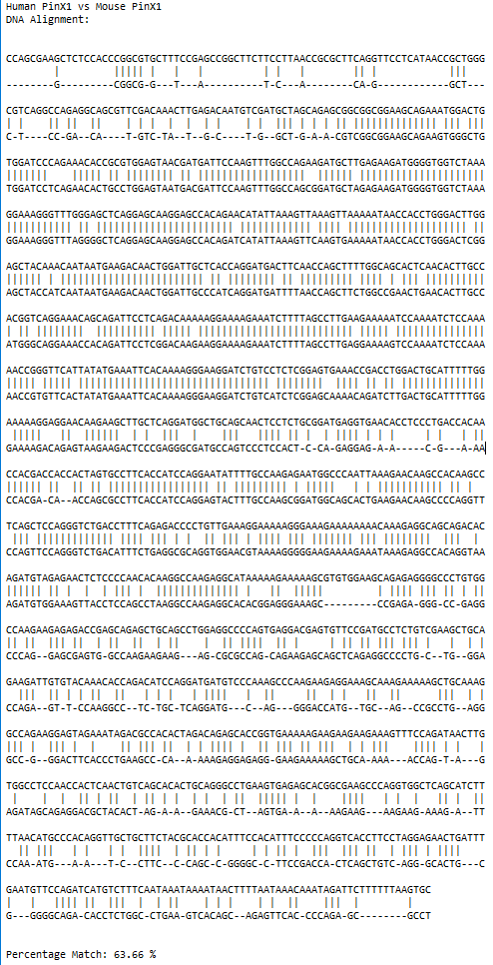
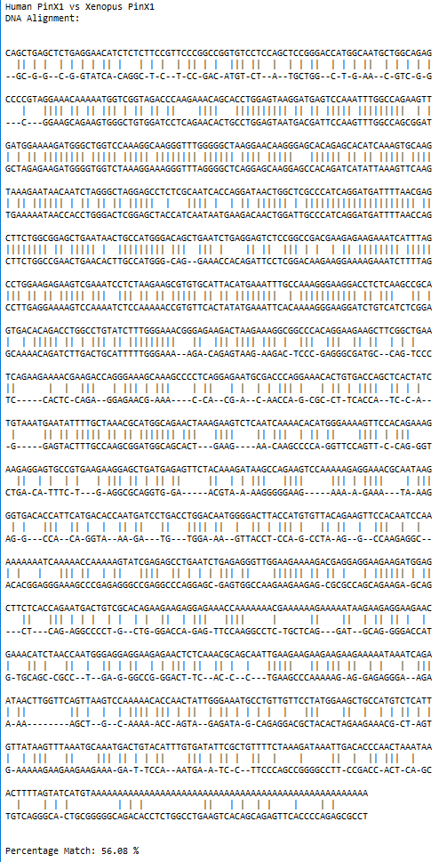
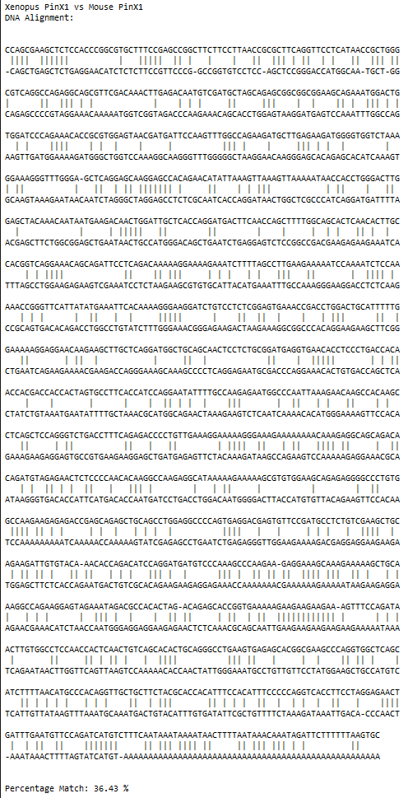

Slide 8
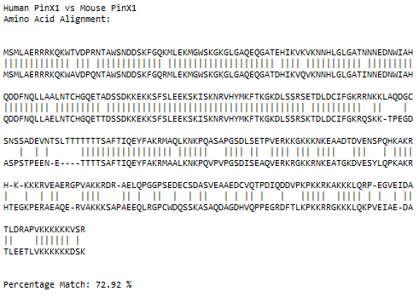
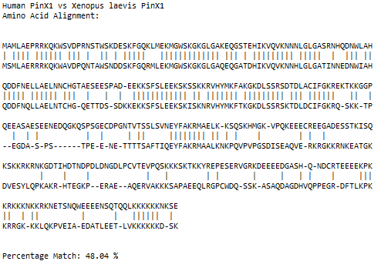
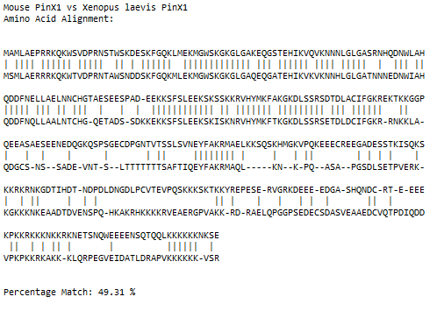
AMINO ACID ALIGNMENTS

Slide 9
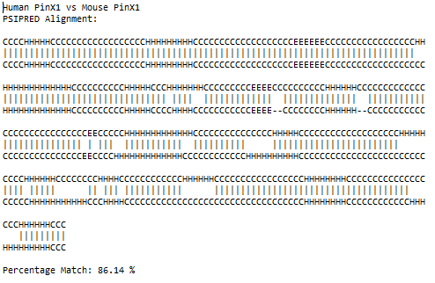
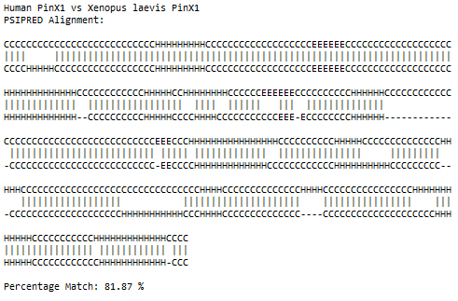
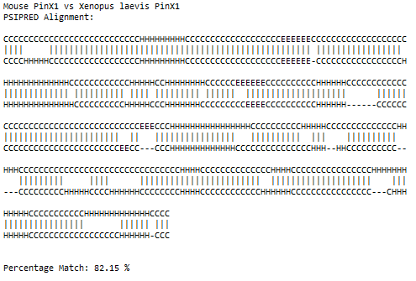
PSIPRED

Slide 10
Conclusions
DNA sequence alignments:
DNA sequences do not appear to be very well conserved, especially in the c-terminal region.
Amino acid alignments:
All PinX1 orthologs share amino acid sequence similarity in the N-terminal region
C-terminal regions are less well conserved
PSIPRED “alignment”
PinX1 predictions look more similar, with helices in similar regions. The C-terminus is better conserved in PSIPRED predictions.

Slide 11
References:
Condon, Richard (2013). PinX1 inhibition of telomerase and PCR. Reed College.
Cylinder, Richard (2012). Inhibition of Telomerase by Xenopus laevis Partial xPinX1 Proteins. Reed College.
Posert, Richard (2014). Structural Characteristics of the PinX1 Telomerase Inhibitory Domain. Reed College.
Zhou, X.Z., and Lu, K.P. (2001). The Pin2/TRF1-interacting protein PinX1 is a potent telomerase inhibitor. Cell 107, 347–359.

