Slide 1
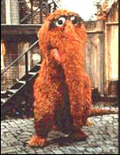
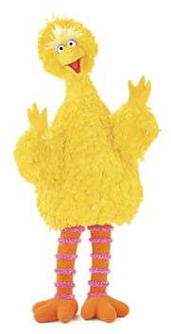

The Recent Change in Visibility of
Imaginary Animal Friends.
Author #1 Author #2 Reed College Bio342
When, Where and Why imaginary animals choose to make
themselves visible to adults continues to baffle animal behavior
researchers. We explore this the adaptive value of this behavior.
“Snuffleupagus is
good organism
with which to
address this question”
Aloysius Snuffleupagus
is a Muppet characters(1)
has appeared on Sesame Street (2).
resembles a wooly mammoth
is a friend of Big Bird.
For many years, Big Bird was the only character who saw him
WHY HAS THIS NOW CHANGED?

Slide 2

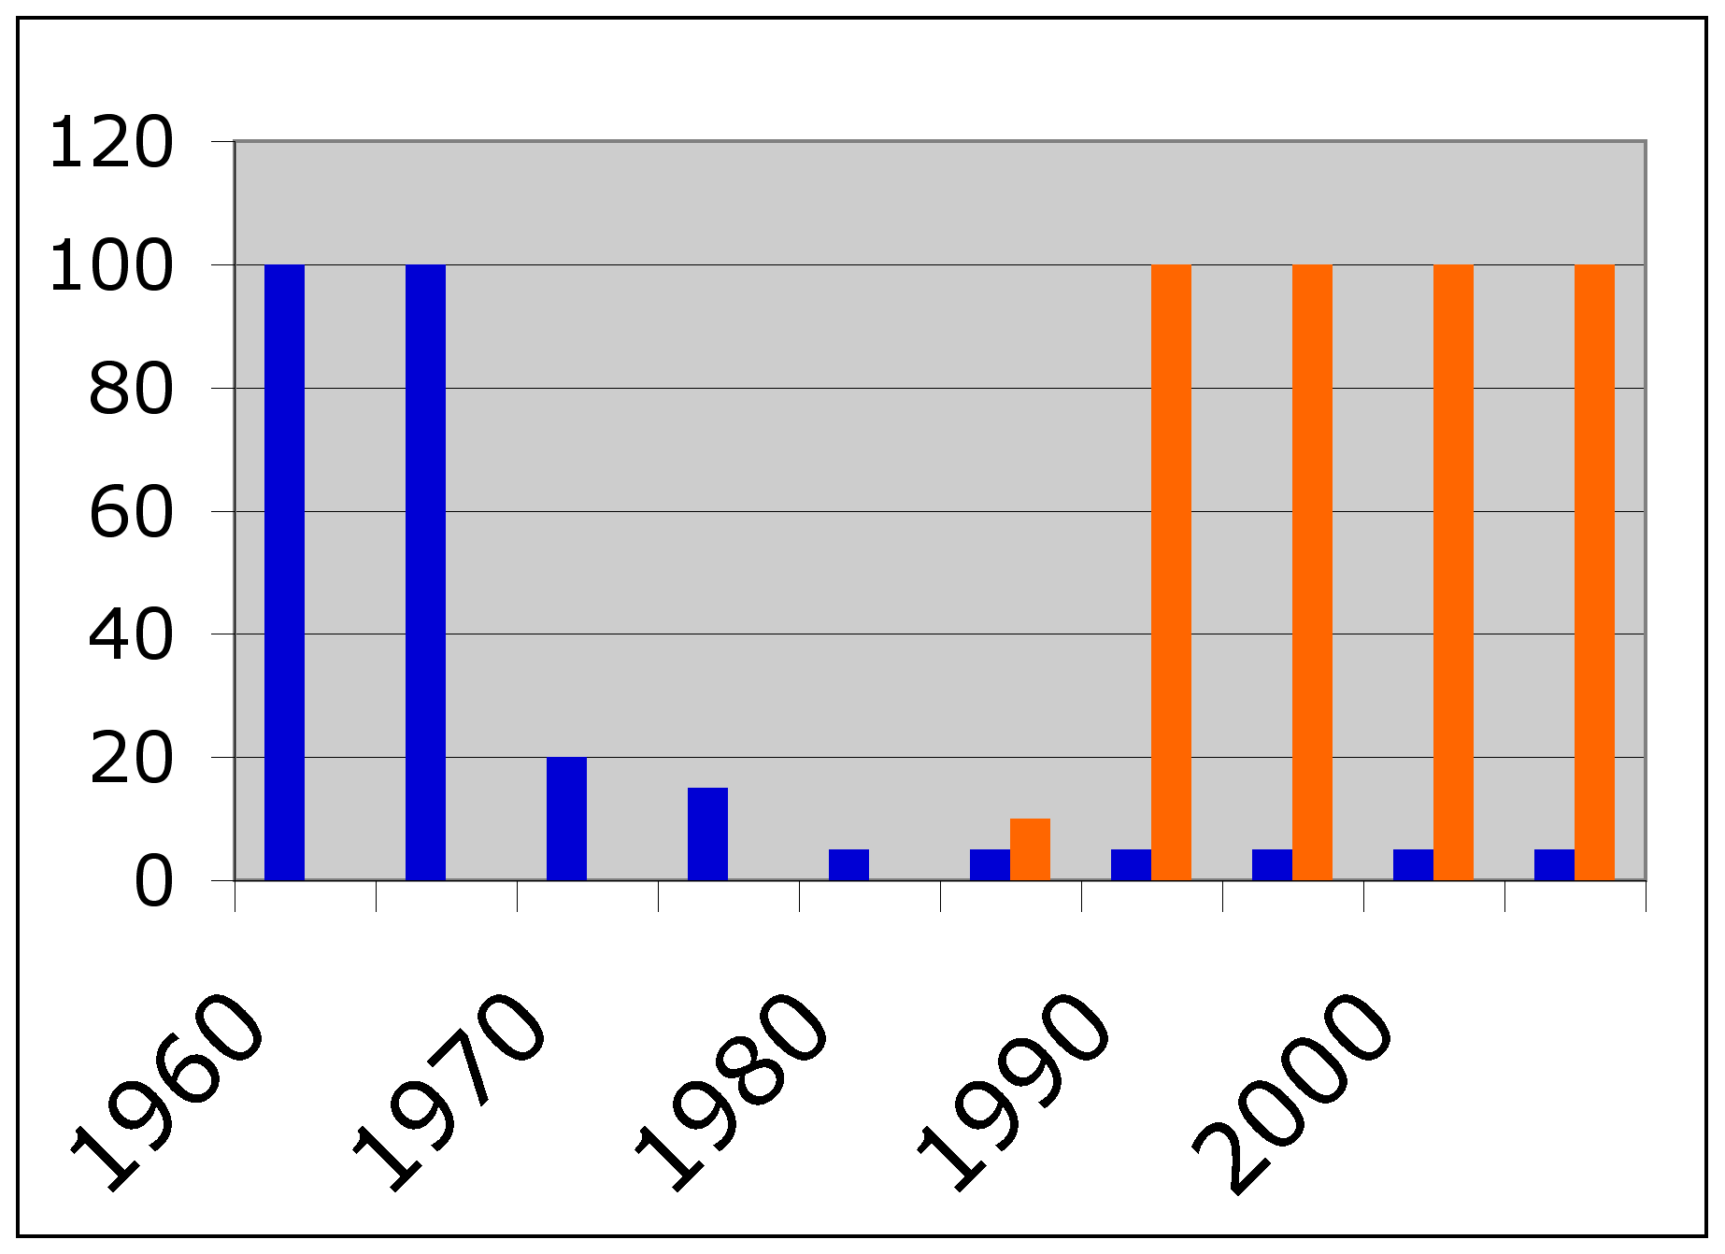
Experimental Design and Results:
In the early years of Snuffy's entrances were
scored by a low-range brass musical cue
Hypothesis: Over Time Adults Learned to Hear the low-range
brass music and knew to look for Snuffy
3023 hours of Sesame Street episodes were observed
Using Jwatcher (3) software event recorder. Adult reactions
And background music were recorded with each appearance
Of Snuffleupagus
http://www.jwatcher.ucla.edu/
The observed decline in music pre dated the reaction by adult’s by over a decade.
% of snuffy appearances
Brass music
Adult reaction
year
Figure 1: the Percent of appearances by Snuffleupagus that were preceded by brass music (blue bars)
And the percent of appearances that elicited an adult’s reaction (orange bars).

Slide 3

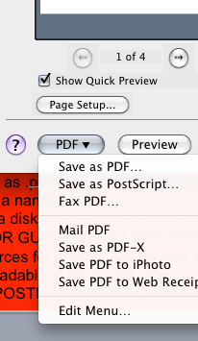
More Results Reveal…….:
In order to print your poster you must first adjust the page setup and save it as a .pdf file.
Select “page setup” from the file menu
select the “options” button and a new window will open
from the “paper size” menu select the last item “manage custom sizes”
A new window opens
click on the “+” button to start a new custom size.
double click on “untitled” and name it “horizontal”
manually enter 11 for the width and 17 for the height
adjust the margins to 0.5 inches
click ok
Now be sure to select your new format from the “paper size” window
Be sure that the dude rotated to his right is selected for orientation of printing.
click ok
click ok
Select “print” from the file menu
Check that your entire image is visible in the preview – use scale to fit
Select “PDF” in the lower left corner of the window.
choose “print as .pdf” from the pull down menu
give your file a name.
save this on a disk or USB
Open your .pdf in preview to check that it looks right
Take your .pdf file to the printing center (Elliot Basement)
THE DEADLINE FOR GUARENTEED PRINTING IS MONDAY AT 5:00 pm after this you will have to use
you own resources for printing. Black and white is acceptable just be sure that your images and graphs
are clearly readable in black and white.
Also POST YOUR .pdf POSTER ON THE COURSES SERVER FOR GRADING !!!!!

Slide 4
It is just not the same anymore.
Our data does not support the
adult learning hypothesis.
Select your own background color (ctrl click or right click on background)
and color scheme, Choose a font that you like. (purposely chose ugly ones so that you would pick your own)
Be sure that the text is large enough to be read from a distance.
The poster should prompt discussion.
It need not include 100% of the details necessary to reproduce your
experiments.
It should tell us why you did the experiment,
what the experiment was,
what results you obtained,
how you interpret those results in the context of what is known
References:
(1) http://en.wikipedia.org/wiki/Muppet
(2) http://en.wikipedia.org/wiki/Sesame_Street
(3) http://www.jwatcher.ucla.edu/
Ewald LA (2005) Sesame Street and the reform of children's television.
Library Journal 130 (20): 133-135.
Austin EW (2004) "G" is for growing: Thirty years of research on children and sesame street.
Journalism & Mass Comm. Quart. 81 (4): 940-94.
Cited figures
Any images used
Acknowledgements:
Don’t forget your TA, Stockroom
other scientist who answered questions
Other students who gave you feedback

