Slide 1
Methods for Forecasting Seasonal Items With Intermittent Demand
Chris Harvey
University of Portland

Slide 2
Overview
What are seasonal items?
Assumptions
The (π,p,P) policy
Software Architecture
Simulation Results
Further work

Slide 3
Seasonal Items
Many items are not demanded year round
  Christmas ornaments
  Flip flop sandals
Demand is sporadic
  Intermittent
Evaluate policies that minimize overstock, while maximizing the ability to meet demand.

Slide 4
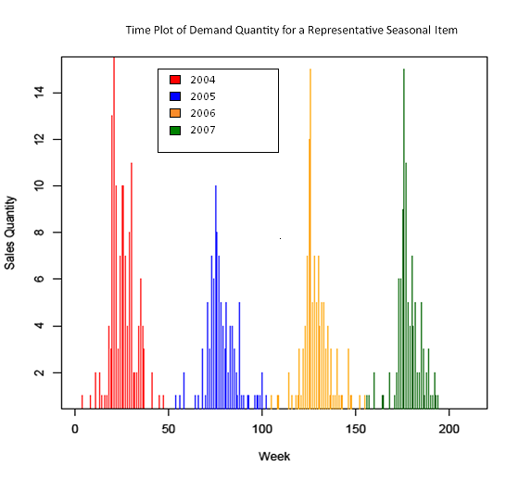
Demand Quantity of a Representative Seasonal Item

Slide 5
Assumptions
Time till demand event is r.v. T, has Geometric distribution
  T ~ Geometric(p_{i}) where p_{i} = Pr(demand event in season)
  T ~ Geometric(p_{o}) where p_{o} = Pr(demand out of season)
Geometric distribution defined for n = 0,1,2,3…
where r.v. X is defined as the number (n) of Bernoulli trials until a success.
pmf →
http://en.wikipedia.org/wiki/Geometric_distribution
Notes:
Add this infor to respective dist slides. Itallicize any math symbols

Slide 6
Assumptions
Size of demand event is r.v. D, has a shifted Poisson distribution
  D ~ Poisson(λ_{i})+1 whereλ_{i}+ 1 = E(demand size in season)
  D ~ Poisson(λ_{o})+1 whereλ_{o}+1 = E(demand out of season)
Poisson distribution defined as
Where r.v. X is number of successes (n) in a time period.
Pmf →
http://en.wikipedia.org/wiki/Poisson_distribution

Slide 7
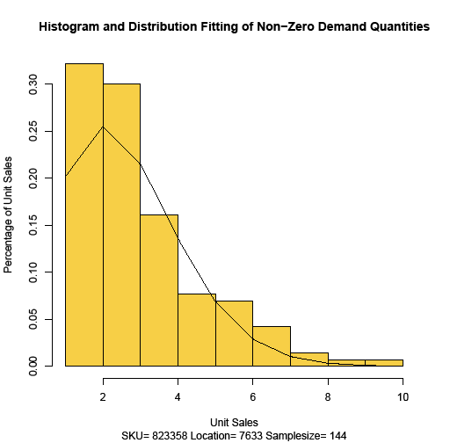
Histogram and Distribution Fitting of
Non-Zero Demand Quantities

Slide 8
The (π, p, P) policy
Order When
Order Quantity
Notes:
The first two thresholds; will there be a demand and will we be able to cover it? Order quantity, given a demand that we cannot cover, what size order does this justify?

Slide 9
New Simulation Structure
Organization
  Modular
  Interchangeable
  Bottom up debugging
Global Data Structure
  Very fast runtime
  [[lists]] nested in [lists]
    Lists may contain many types: vectors, strings, floats, functions…
Main simulation:
Data structure aware
Director for Each Method:
Data Structure ignorant
Generic Function definitions
Generic call args
Specific call args
Generic return args
Specifc return args
Notes:
Be sure to emphasize the role of the Director as an intermediary between the main simulation program and the method specific code modules. Your diagram does a nice job of illustrating this, but non-programmers may not easily see why this is so important (and cool). Emphasize that this allows the main sim coding to be completely ignorant of method details and, similary, the method modules need know absolutely nothing about the simulation code (and therefore can be reused in other applications including, potentially, production applications).

Slide 10
Performance

Slide 11
ROII for π =.9
P
p

Slide 12
Future Work
Bayesian Updating
  Geometric and Poisson parameters are not fixed
  Parameters have a probability distribution based on observed data
  Parameters are continuously updated with new information
Modular nature of new simulation allows fast testing of new updating methods

Slide 13
Giving Thanks
Dr. Meike Niederhausen
Dr. Gary Mitchell
R

