Slide 1
Visual(Eyes)Ing
Predicted Phenotypic Probabilities
By: Simue` Rose Isabel

Slide 2
The Problem
A Solution
Re-define actual eye phenotypes into three categories
Standardize colorlist language
Create a probability table
Visualize actual eye color data in colorized scatterplot
Data from three countries (Ireland, Greece, and Poland) from 1,551 subjects
Varying phenotypic trends
Slightly inconsistent records of actual phenotypes
Visualizing .txt data with Python
Unnatural population frequency: Green eye color

Slide 3
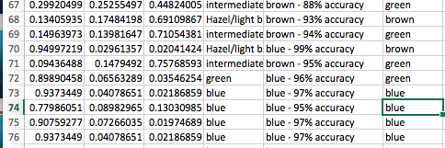
The Easy Way or The Hard Way?
Data used: “The HIrisPlex system for simultaneous prediction of hair and eye colour from DNA” by Susan Walsh, et al.
Easy Way = IF(D74="","",IF(ISNUMBER(SEARCH("brown",D74,1)),"brown",IF(ISNUMBER(SEARCH("blue",D74,1)),"blue","")))
Hard Way = Typing out each actual phenotype for 309 predictions (subject to random error)

Slide 4
Programing
Data into list of list to create frequency table
Probability table plots data points
Organized data points into lists of colors (blue, brown, green)
Plotted data in (6,6) scatterplot
Changed the colors to fit data
Imported manipulated csv file and created function to convert excel info into a reader
Created colorized probability lists to correspond with imported data and plotted points
Forward loop to index and add data to probability list using range & len
Changed strings into floats corresponding to each color_list index number
(‘green’ is green is value of prob_Green)

Slide 5
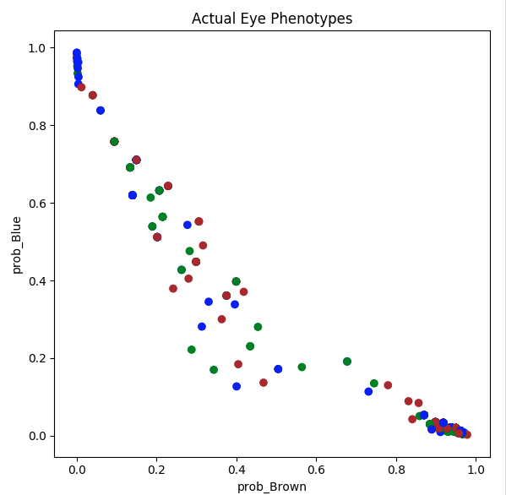

Slide 6
Visualized Results
Probabilities sum to 1
High probability of Blue rarely transforms into actual phenotypic expressions of Brown or Green
High probability of Brown, expresses itself as Blue and Green more frequently than high prob_Blue
The frequency of Green eye color is present within the population, when prob_Blue and prob_Brown are lower
Green eye color appears more frequently when prob_Brown is higher

Slide 7
Works Cited
The HIrisPlex system for simultaneous prediction of hair and eye colour from DNA.Walsh, Susan et al. Forensic Science International: Genetics , Volume 7 , Issue 1 , 98 – 115.

