Slide 1
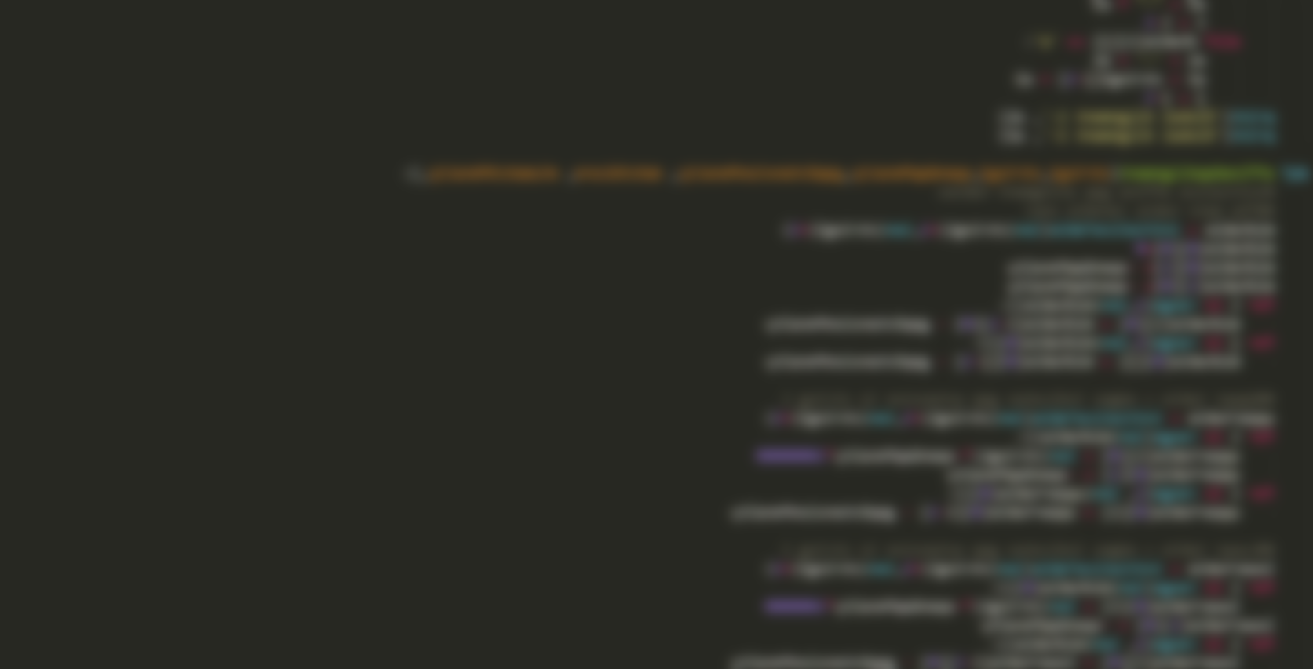
Affine Gap Alignment - An improved global alignment
Code Structure
Data
Results
interpretation
Bio 131 individual project Yu Fu, O56922

Slide 2
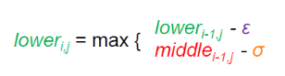
- Initialize 4 tables instead of 2 (3 alignment tables + 1 backtrack table)
- Fill the alignment tables (Dynamic programming)
- Fill the backtrack table
- Table to Alignment
Bio 131 individual project Yu Fu, O56922

Slide 3
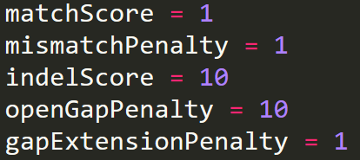
- Data
- Short sequences for testing
- Real Sequences
Bio 131 individual project Yu Fu, O56922

Slide 4
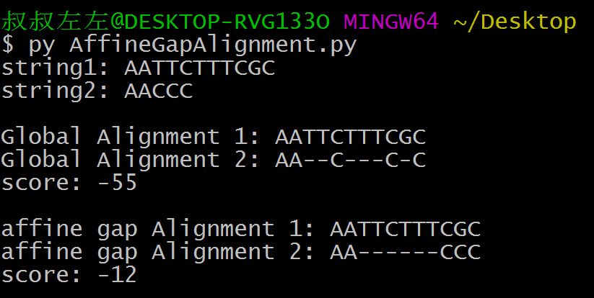
- Data
- Short sequences for testing
- Result
It works!
Bio 131 individual project Yu Fu, O56922

Slide 5
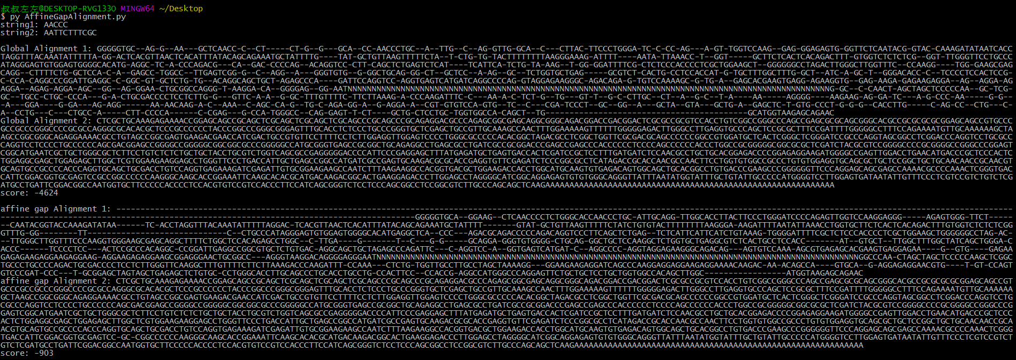
- Data
- Real Sequences
Score = -4624
Score = -903
Bio 131 individual project Yu Fu, O56922

Slide 6
More Gaps
Less Gaps

Slide 7
Thank you!
Bio 131 individual project Yu Fu, O56922

